Slide 1


South Florida SQL Server User Group
Hack / Protect / Predict SQL Server – Learn Them
Hiram Fleitas
Universal Property & Casualty Insurance Company
Public: goo.gl/BqfYSi

Slide 2



Session evaluations Your feedback is important and valuable.
goo.gl/QEkoDi
Submit your feedback by the end of this session to win a prize.
goo.gl/QEkoDi
http://hiram/evals

Slide 3





BIO
Father, SQL Server DBA/Dev, IT Pro,
GRT, USCG Auxiliary.
*Dev since 1995.
*SQL since 1999.
Hiram Fleitas
Principal Database Architect @UPCIC
/HiramFleitas
/hfleitas
FUN
Wakeboard, Wakesurf, Snowboard, GORUCK, Family.
@HiramFleitas
hiramfleitas@hotmail.com
HiramFleitas
dba2o.wordpress.com

Slide 4
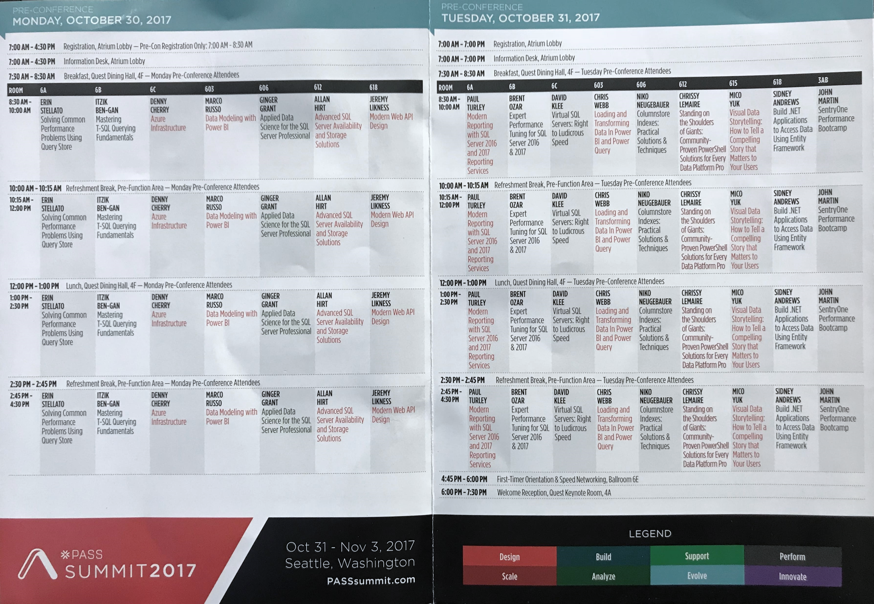
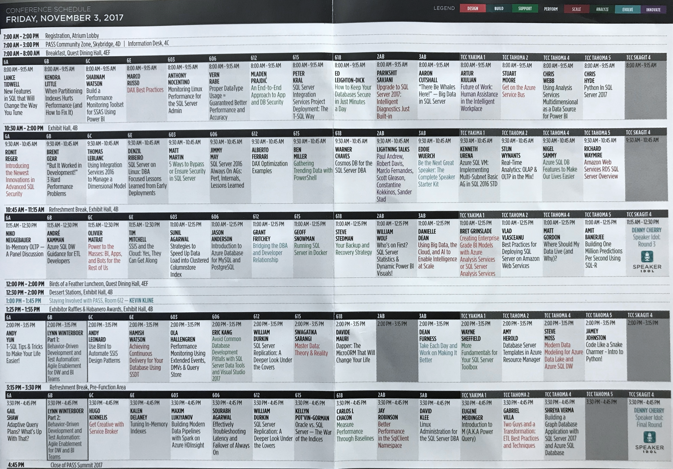
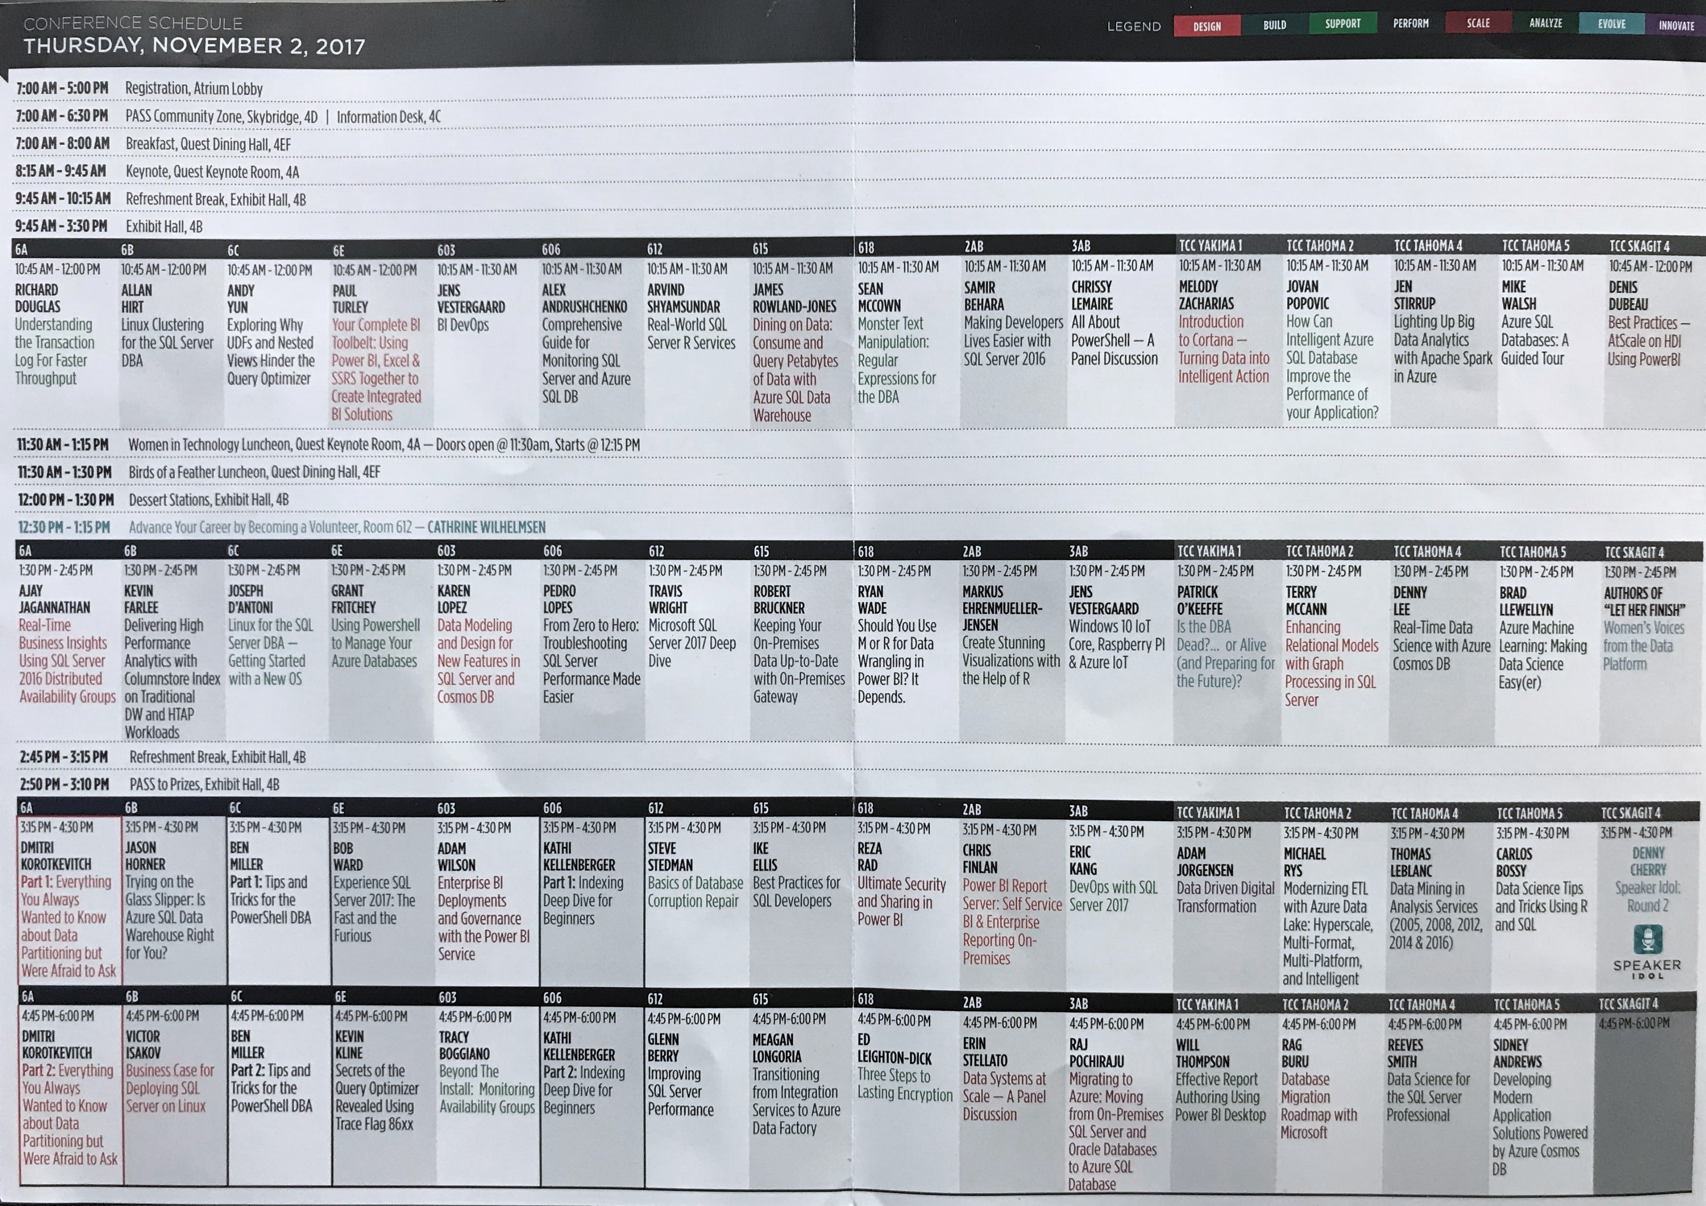
Agenda
Hack Tabular Data Stream (TDS)
Load Test Encryption
Hack Dynamic Data Masking (DDM)
Hack Row-Level Security (RLS)
DB Source Control (TFS/Git)
Real-time Sentiment Prediction (SQL ML/AI DNN)
Resources
Raffle

Slide 5
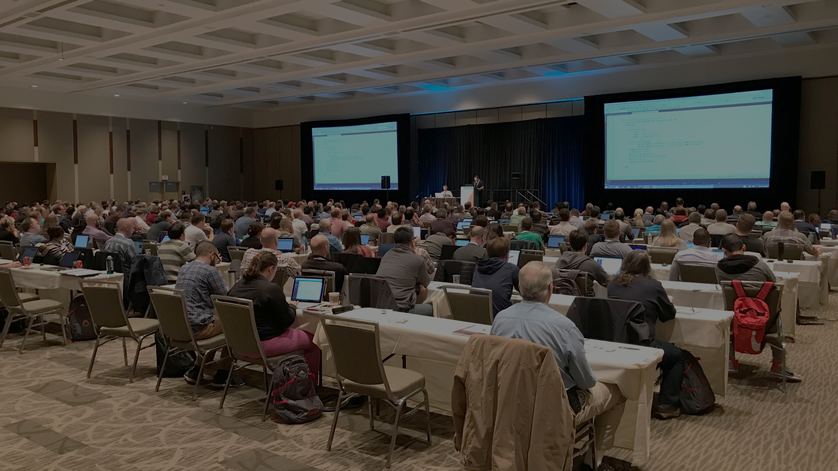
DEMO 1
TDS Encryption
Notes:
Columnstore Demo: (requirements: ssms, sql2016+)
H:\SQL\PassSummit2017\20171101-1100-TSQLTipsAndTricks\2017NeedToKnowAdaptiveJoinsOverRowstore\Demo
Performance 2017 vs 2016: (requirements: hammerdb, sql2016, sql2017)
HammerDB ASP02 (2016), SQL07 (2017) and if time allows do imoltp.
2017 Automatic Tuning: (requirements: perfmon, sqlcmd, ostress.exe, sql2017, wwi db)
C:\Deployments\demo3_sqlserverkeepsyoufast\
Copied ostress.exe into C:\Deployments\demo3_sqlserverkeepsyoufast (I had previously installed RML Utilities)
Replaced “.\sql2017” with “localhost” in files C:\Deployments\demo3_sqlserverkeepsyoufast\*.cmd (I had previously restored wwi on my local instance)
Edited setup.sql, replaced DROP procedure with DROP procedure if exists
PowerShell window 1:
PS ran .\report.cmd
PowerShell window 2:
PS perfom, performance monitor, added SQLServer:SQL Statistics:Batch Requests/sec.
PS .\repro_setup.cmd
PS .\initialize.cmd
PS .\auto_tune.cmd
PS .\regression.cmd
Docker: (requirements: docker, bios virtualization, git, stop mssql and iis local instances)
PS cd c:\deployments\sqldevops\docker_cluster\aks
Power BI:
https://community.powerbi.com/t5/Data-Stories-Gallery/US-Department-of-Transportation-Traffic-accident-analysis-1990/m-p/152287
C:\Deployments\PowerBI\USA-CAN TOR.pbix

Slide 6
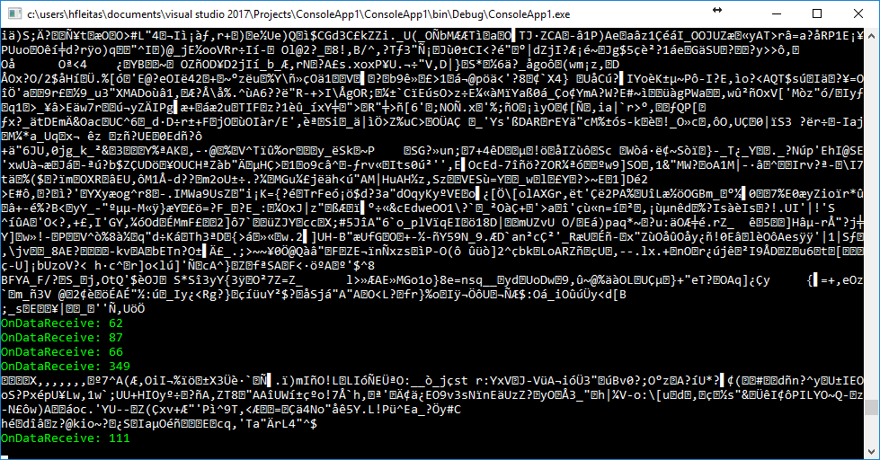

Force Encryption

Slide 7
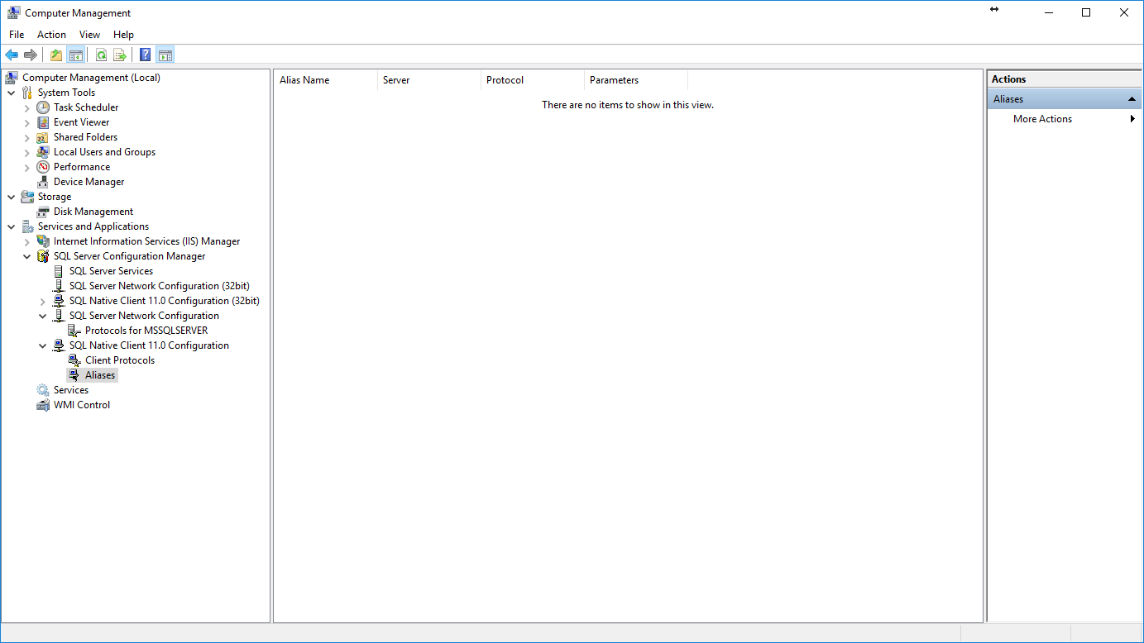
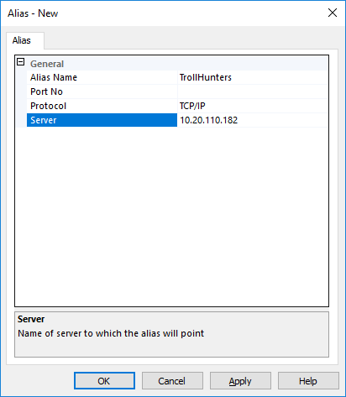
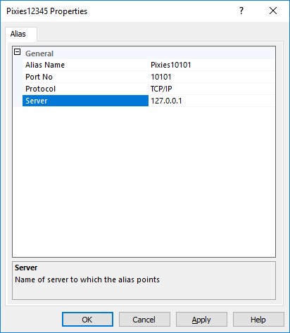
Notes:
Trollhunters MTM: (requirements: ssms, sql2008+, remote svr, vs2017 community, wireshark)
\\fldsvm_uvfile02\users$\hfleitas\SQL\PassSummit2017\20171101-1300-HackingSQLServer\TrollHunters-MITM-Demo.sql
*port number is required in alias name for the hack by TcpForwarderSlim.

Slide 8
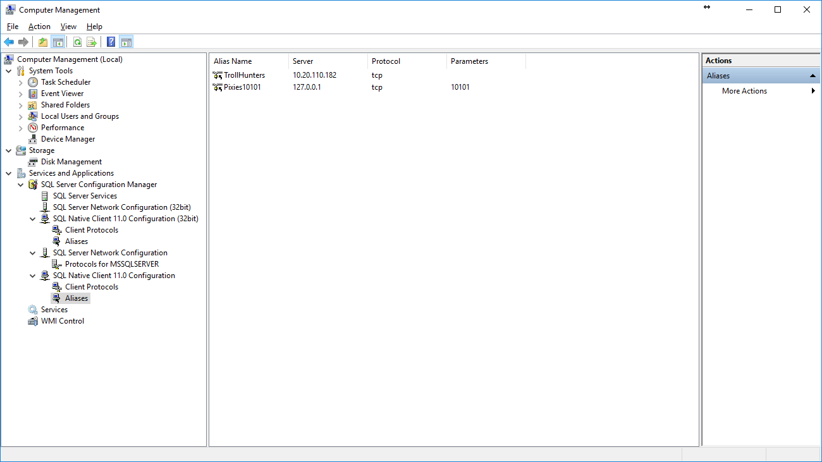
Notes:
Trollhunters MTM: (requirements: ssms, sql2008+, remote svr, vs2017 community, wireshark)
\\fldsvm_uvfile02\users$\hfleitas\SQL\PassSummit2017\20171101-1300-HackingSQLServer\TrollHunters-MITM-Demo.sql

Slide 9
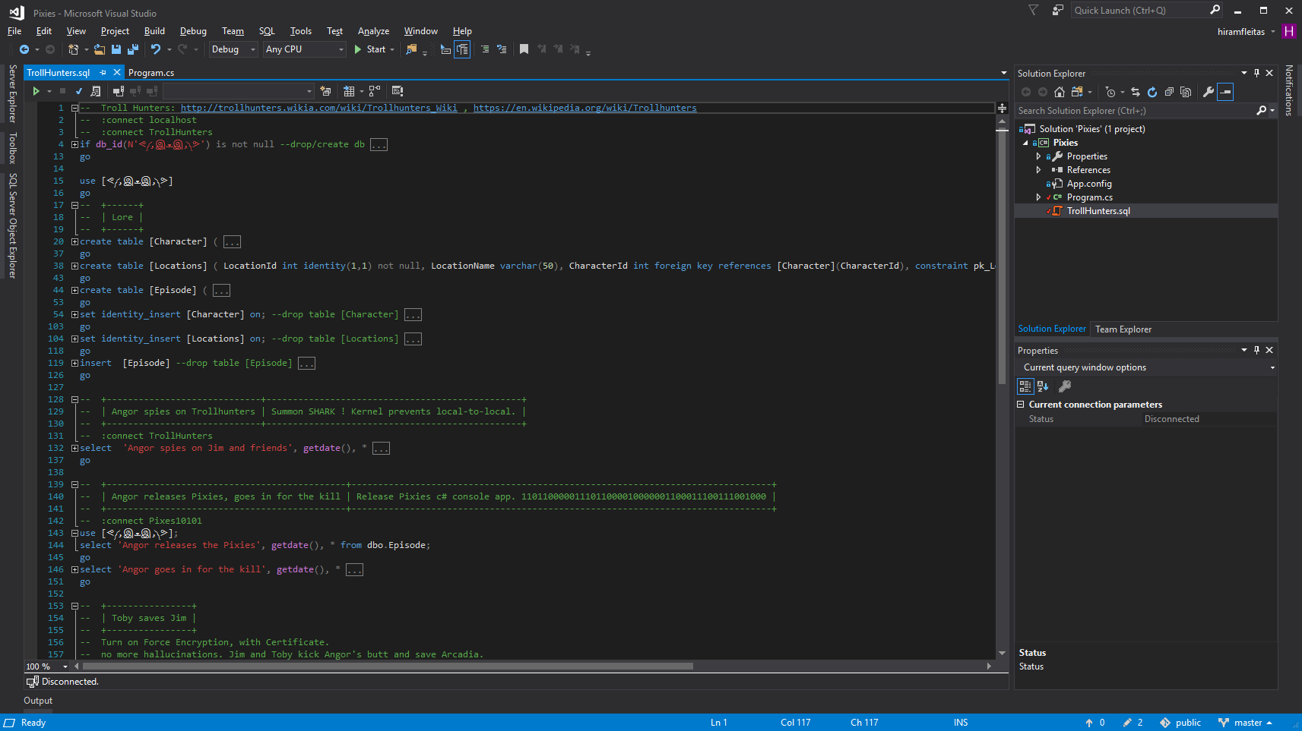
Notes:
Trollhunters MTM: (requirements: ssms, sql2008+, remote svr, vs2017 community, wireshark)
\\fldsvm_uvfile02\users$\hfleitas\SQL\PassSummit2017\20171101-1300-HackingSQLServer\TrollHunters-MITM-Demo.sql

Slide 10
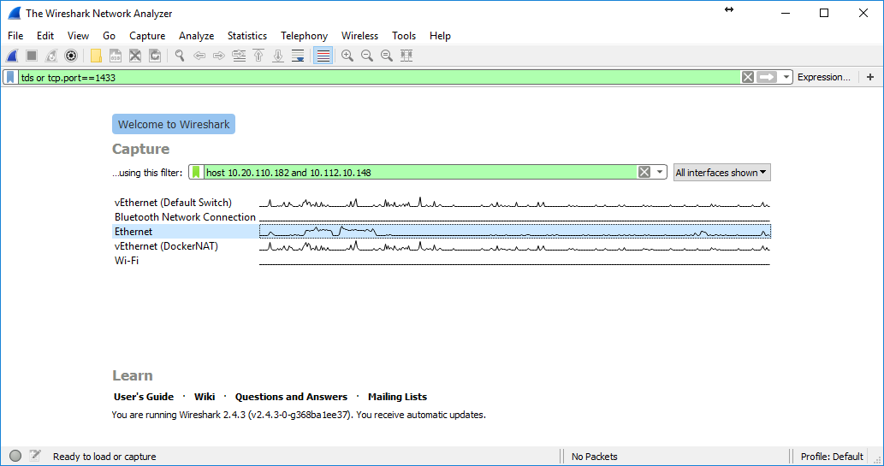
Notes:
Trollhunters MTM: (requirements: ssms, sql2008+, remote svr, vs2017 community, wireshark)
\\fldsvm_uvfile02\users$\hfleitas\SQL\PassSummit2017\20171101-1300-HackingSQLServer\TrollHunters-MITM-Demo.sql

Slide 11
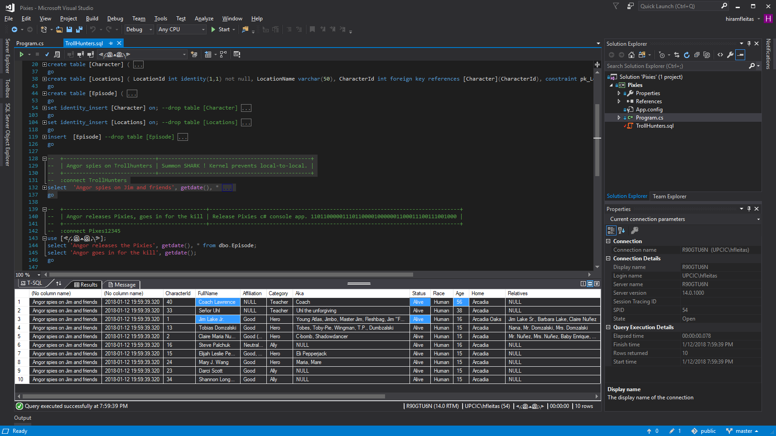
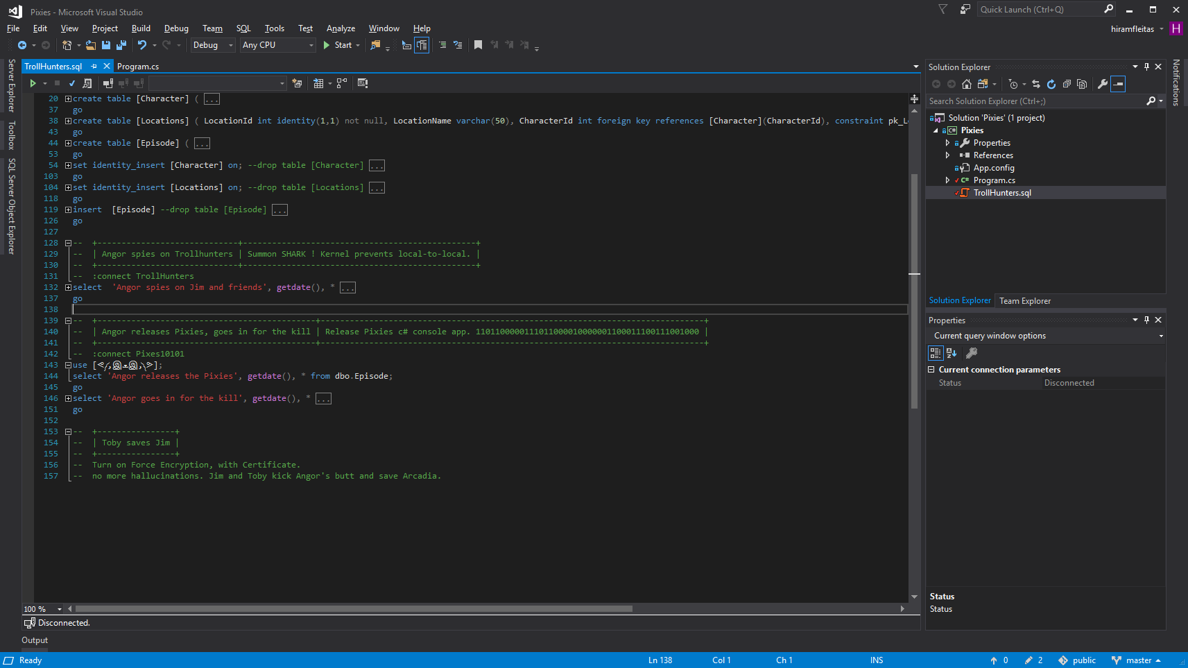
Notes:
Trollhunters MTM: (requirements: ssms, sql2008+, remote svr, vs2017 community, wireshark)
\\fldsvm_uvfile02\users$\hfleitas\SQL\PassSummit2017\20171101-1300-HackingSQLServer\TrollHunters-MITM-Demo.sql

Slide 12
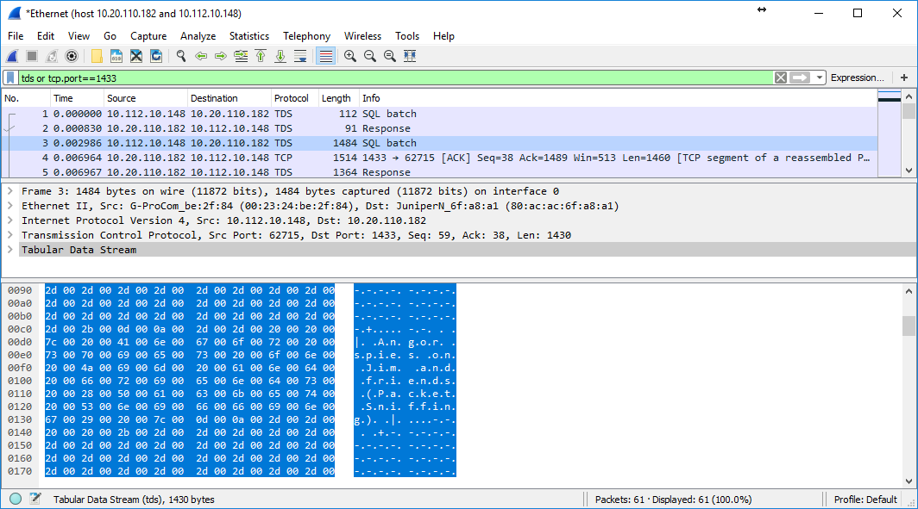
Notes:
Trollhunters MTM: (requirements: ssms, sql2008+, remote svr, vs2017 community, wireshark)
\\fldsvm_uvfile02\users$\hfleitas\SQL\PassSummit2017\20171101-1300-HackingSQLServer\TrollHunters-MITM-Demo.sql

Slide 13
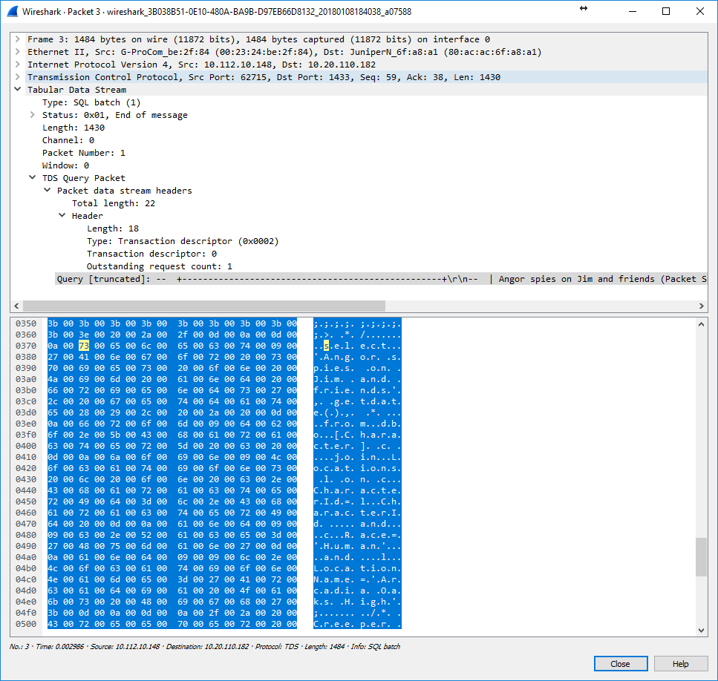
Notes:
Trollhunters MTM: (requirements: ssms, sql2008+, remote svr, vs2017 community, wireshark)
\\fldsvm_uvfile02\users$\hfleitas\SQL\PassSummit2017\20171101-1300-HackingSQLServer\TrollHunters-MITM-Demo.sql

Slide 14
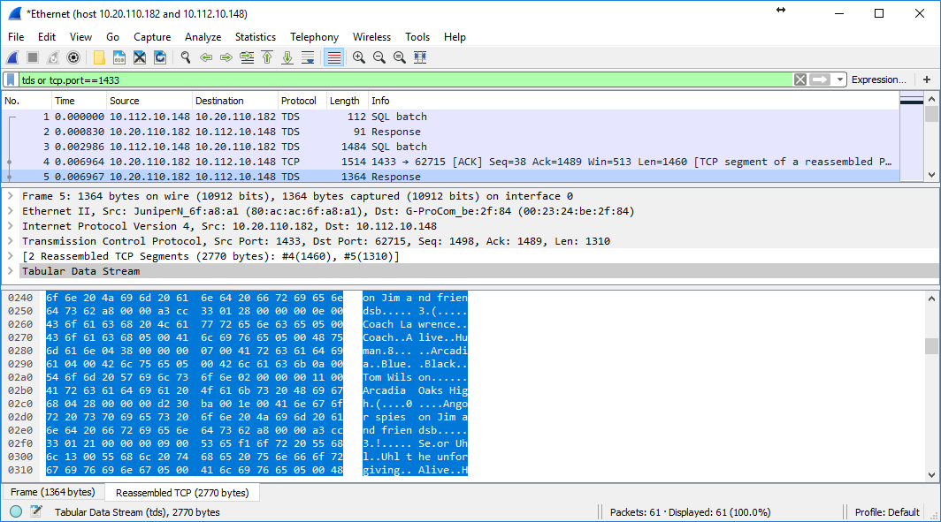
Notes:
Trollhunters MTM: (requirements: ssms, sql2008+, remote svr, vs2017 community, wireshark)
\\fldsvm_uvfile02\users$\hfleitas\SQL\PassSummit2017\20171101-1300-HackingSQLServer\TrollHunters-MITM-Demo.sql

Slide 15
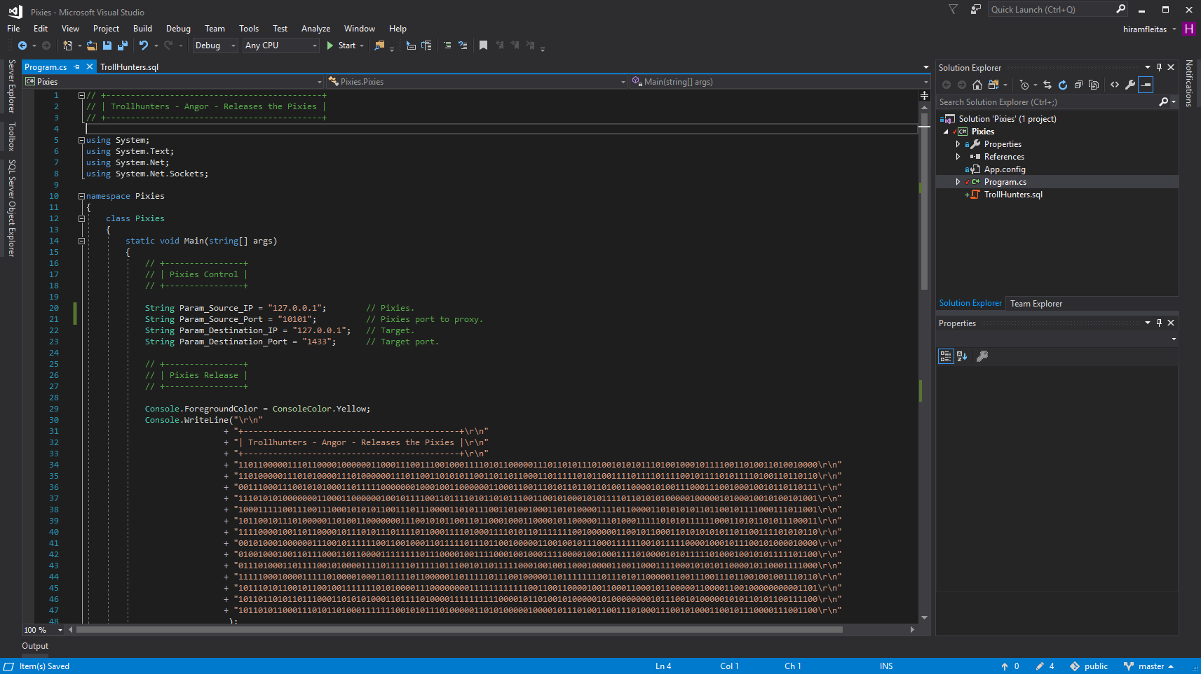
Notes:
Trollhunters MTM: (requirements: ssms, sql2008+, remote svr, vs2017 community, wireshark)
\\fldsvm_uvfile02\users$\hfleitas\SQL\PassSummit2017\20171101-1300-HackingSQLServer\TrollHunters-MITM-Demo.sql

Slide 16
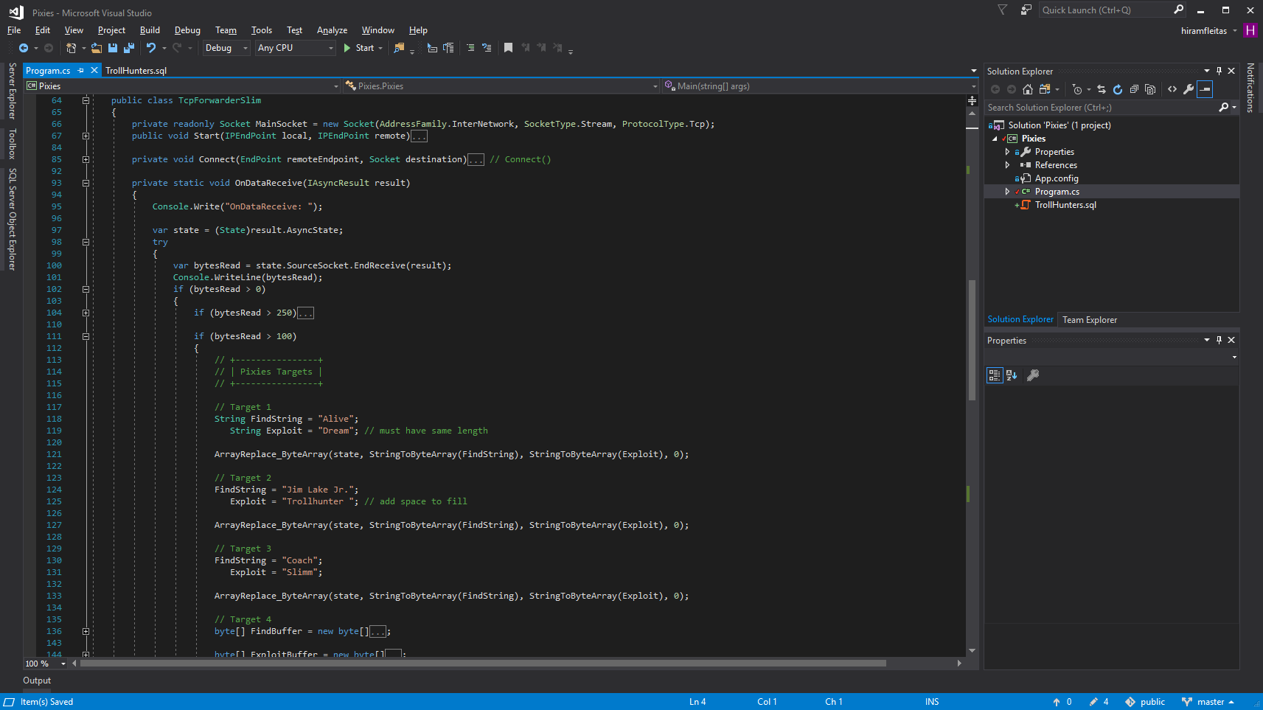
Notes:
Trollhunters MTM: (requirements: ssms, sql2008+, remote svr, vs2017 community, wireshark)
\\fldsvm_uvfile02\users$\hfleitas\SQL\PassSummit2017\20171101-1300-HackingSQLServer\TrollHunters-MITM-Demo.sql

Slide 17
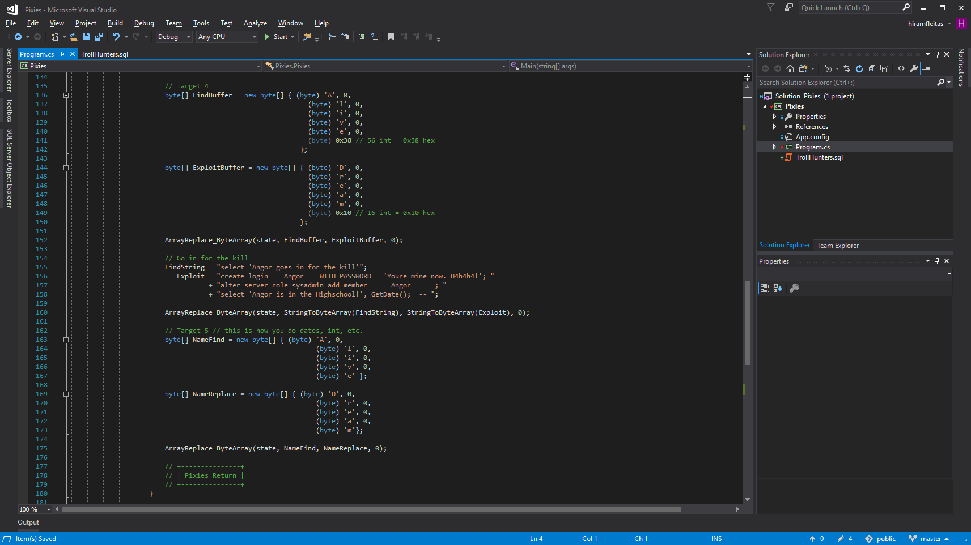
Notes:
Trollhunters MTM: (requirements: ssms, sql2008+, remote svr, vs2017 community, wireshark)
\\fldsvm_uvfile02\users$\hfleitas\SQL\PassSummit2017\20171101-1300-HackingSQLServer\TrollHunters-MITM-Demo.sql

Slide 18
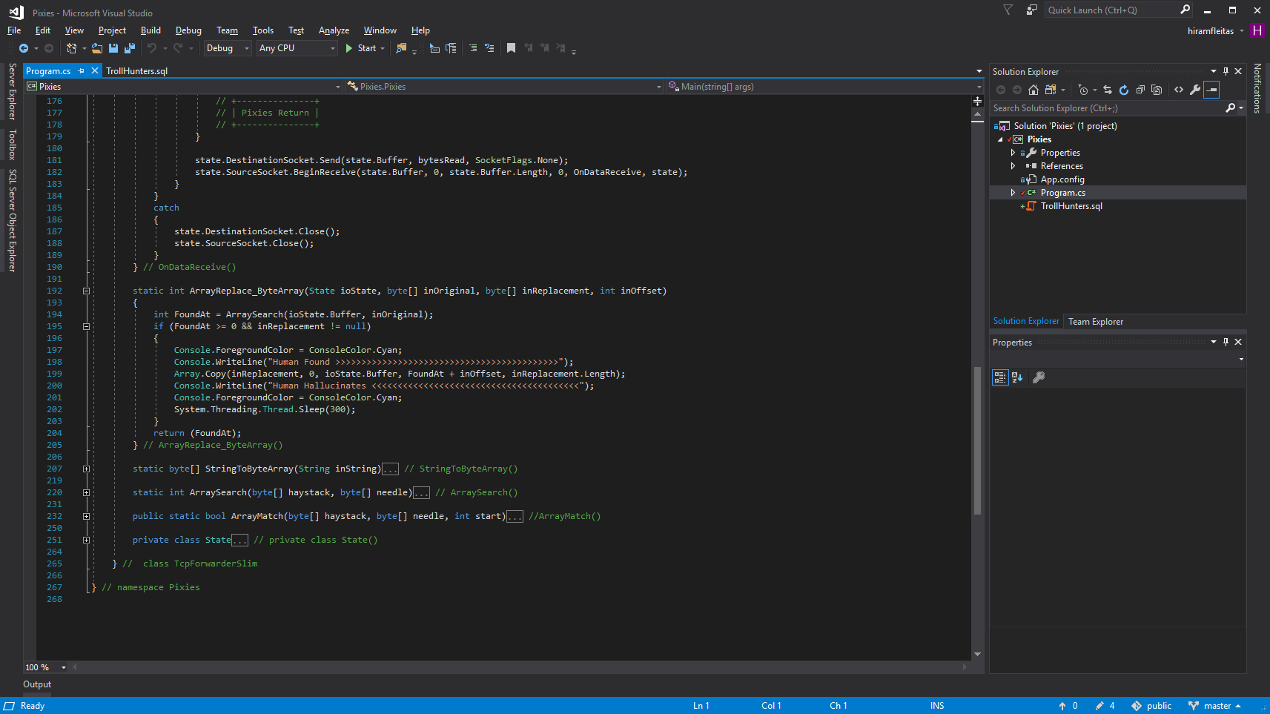
Notes:
Trollhunters MTM: (requirements: ssms, sql2008+, remote svr, vs2017 community, wireshark)
\\fldsvm_uvfile02\users$\hfleitas\SQL\PassSummit2017\20171101-1300-HackingSQLServer\TrollHunters-MITM-Demo.sql

Slide 19
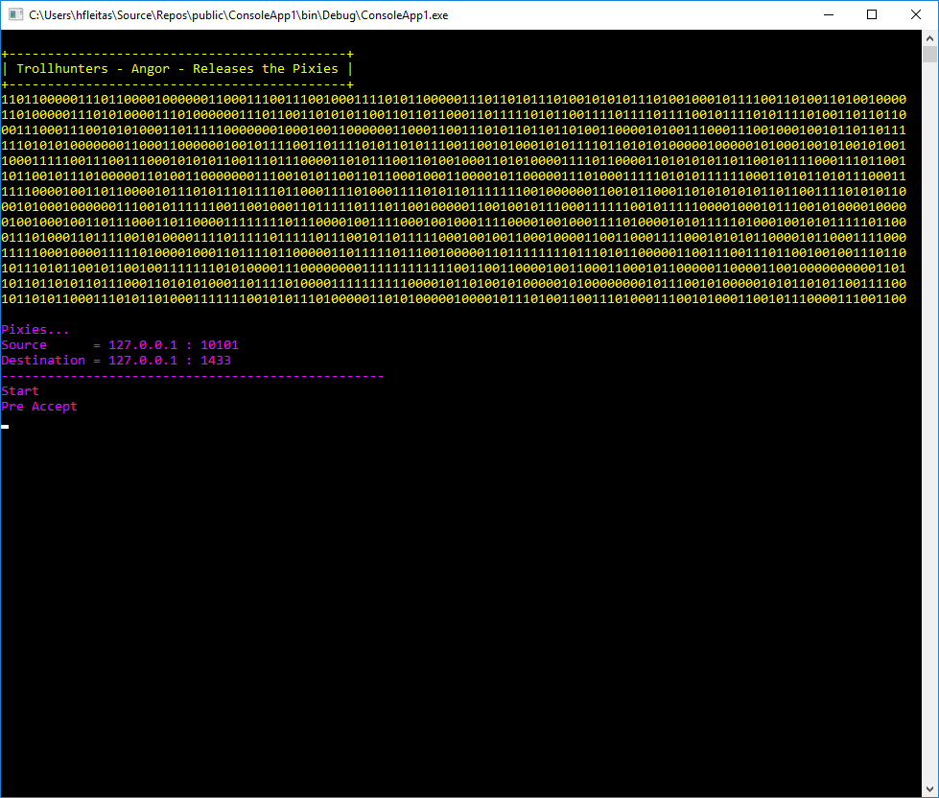
Notes:
Trollhunters MTM: (requirements: ssms, sql2008+, remote svr, vs2017 community, wireshark)
\\fldsvm_uvfile02\users$\hfleitas\SQL\PassSummit2017\20171101-1300-HackingSQLServer\TrollHunters-MITM-Demo.sql

Slide 20
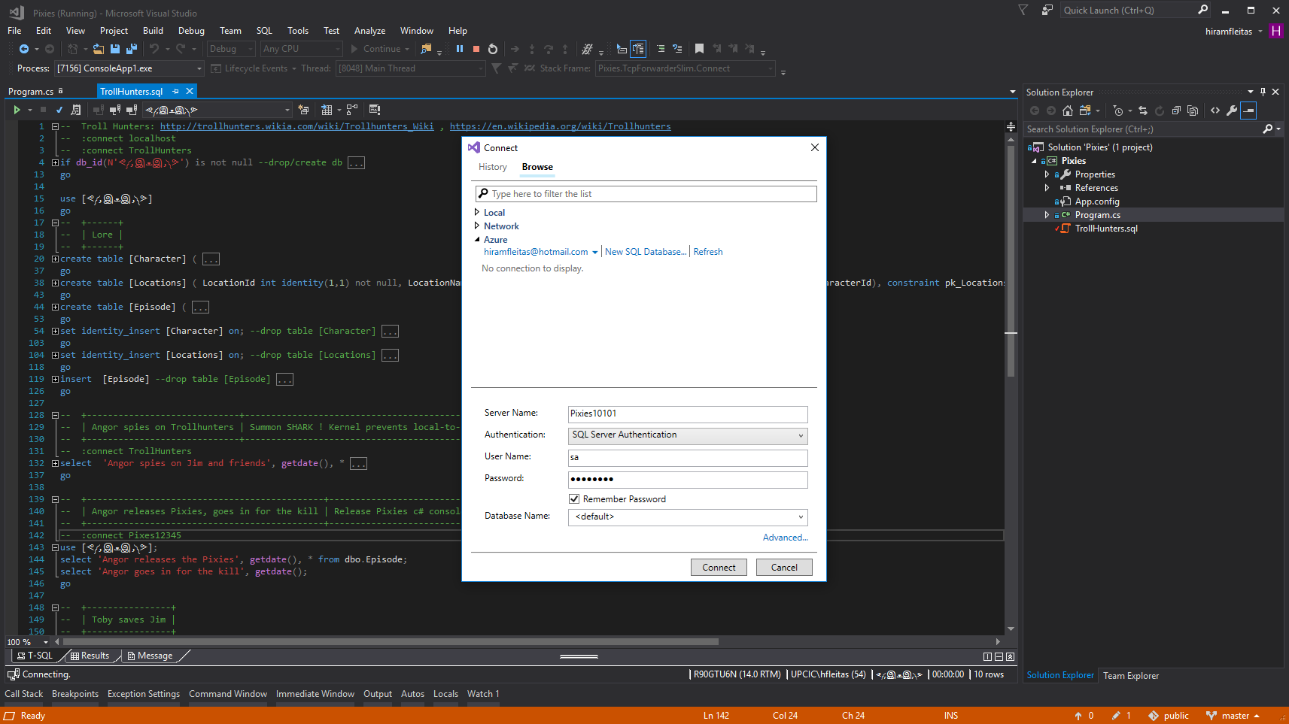
Notes:
Trollhunters MTM: (requirements: ssms, sql2008+, remote svr, vs2017 community, wireshark)
\\fldsvm_uvfile02\users$\hfleitas\SQL\PassSummit2017\20171101-1300-HackingSQLServer\TrollHunters-MITM-Demo.sql
TURN OFF INTELLISENSE before connecting.

Slide 21
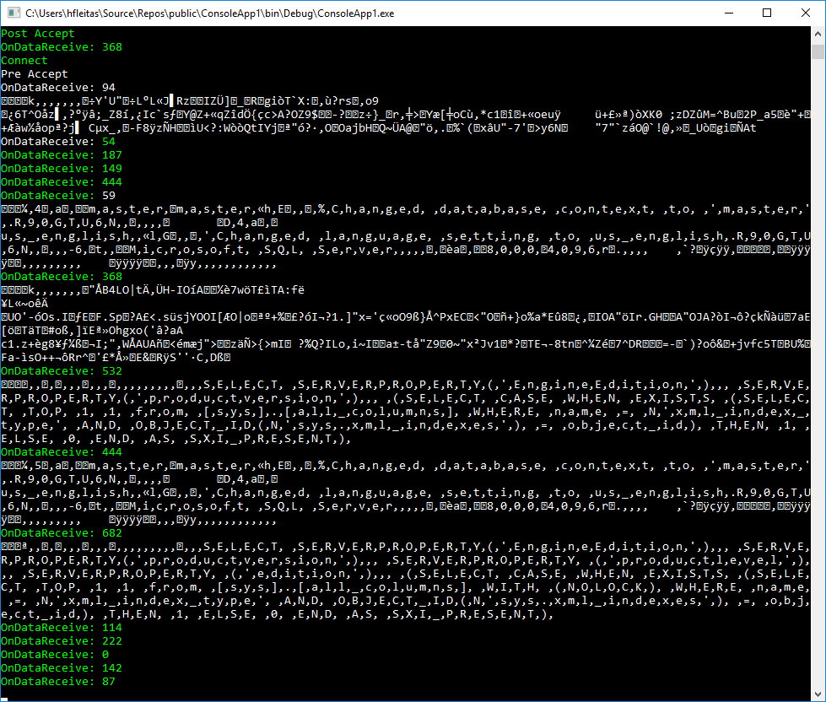
Notes:
Trollhunters MTM: (requirements: ssms, sql2008+, remote svr, vs2017 community, wireshark)
\\fldsvm_uvfile02\users$\hfleitas\SQL\PassSummit2017\20171101-1300-HackingSQLServer\TrollHunters-MITM-Demo.sql

Slide 22
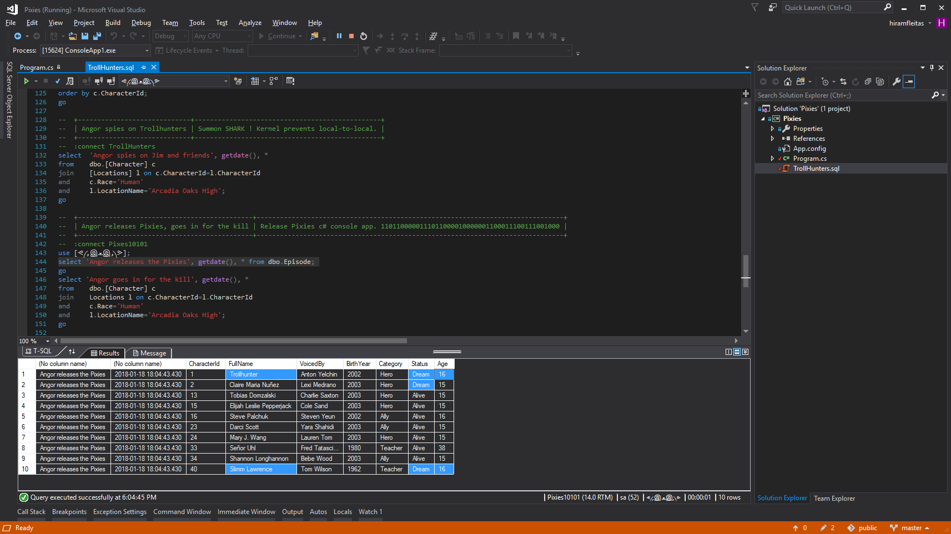
Notes:
Trollhunters MTM: (requirements: ssms, sql2008+, remote svr, vs2017 community, wireshark)
\\fldsvm_uvfile02\users$\hfleitas\SQL\PassSummit2017\20171101-1300-HackingSQLServer\TrollHunters-MITM-Demo.sql

Slide 23
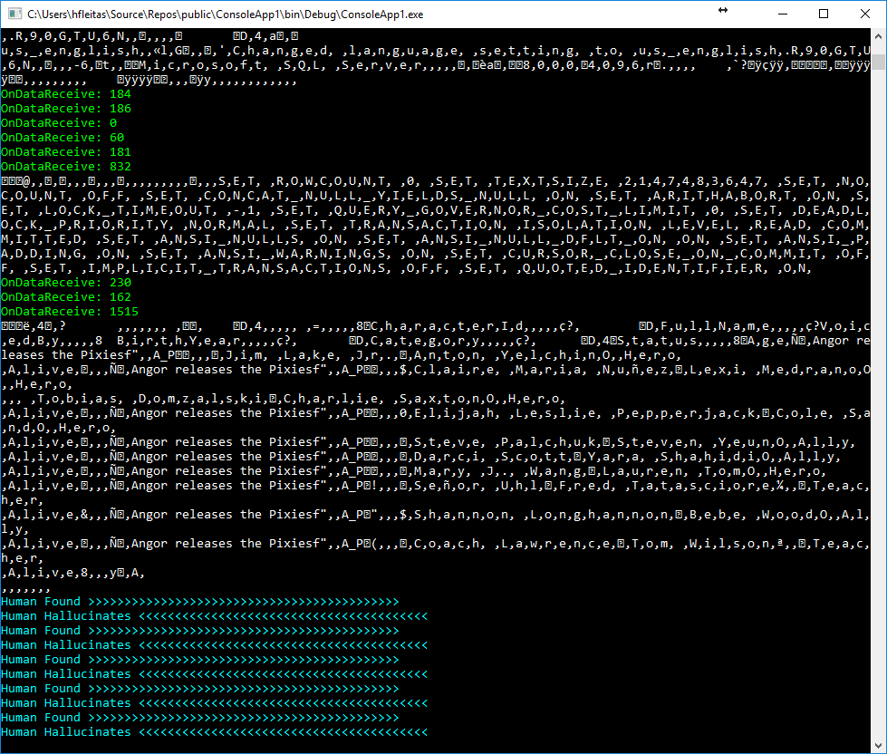
Notes:
Trollhunters MTM: (requirements: ssms, sql2008+, remote svr, vs2017 community, wireshark)
\\fldsvm_uvfile02\users$\hfleitas\SQL\PassSummit2017\20171101-1300-HackingSQLServer\TrollHunters-MITM-Demo.sql

Slide 24
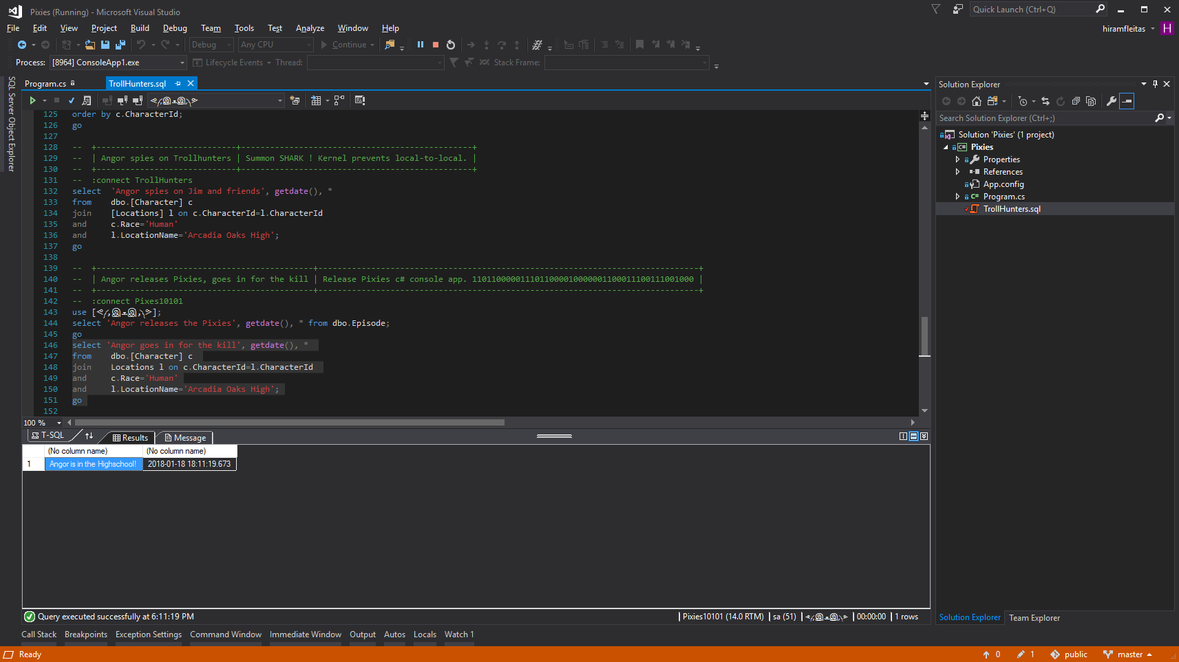
Notes:
Trollhunters MTM: (requirements: ssms, sql2008+, remote svr, vs2017 community, wireshark)
\\fldsvm_uvfile02\users$\hfleitas\SQL\PassSummit2017\20171101-1300-HackingSQLServer\TrollHunters-MITM-Demo.sql

Slide 25
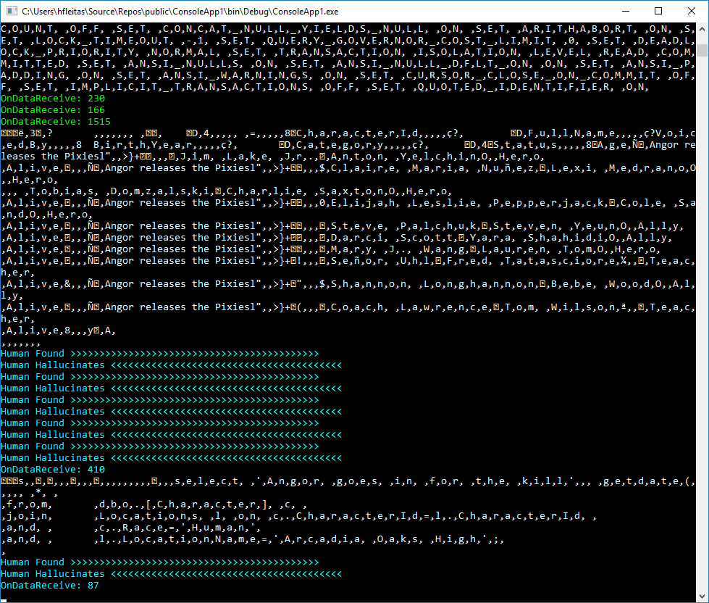
Notes:
Trollhunters MTM: (requirements: ssms, sql2008+, remote svr, vs2017 community, wireshark)
\\fldsvm_uvfile02\users$\hfleitas\SQL\PassSummit2017\20171101-1300-HackingSQLServer\TrollHunters-MITM-Demo.sql

Slide 26
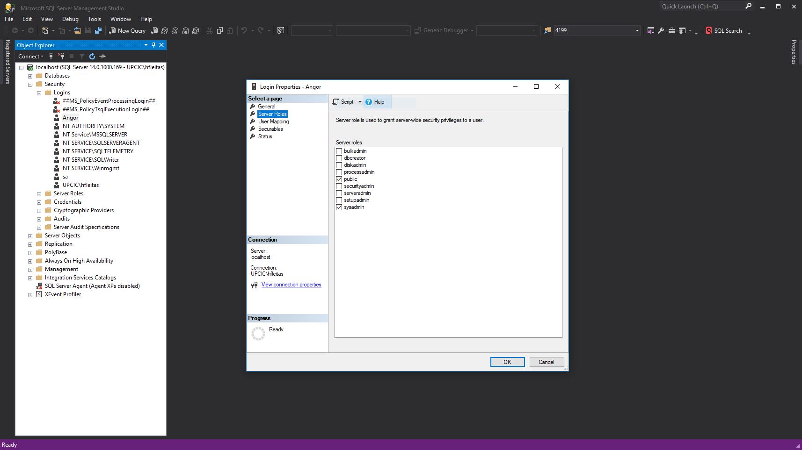
Notes:
Trollhunters MTM: (requirements: ssms, sql2008+, remote svr, vs2017 community, wireshark)
\\fldsvm_uvfile02\users$\hfleitas\SQL\PassSummit2017\20171101-1300-HackingSQLServer\TrollHunters-MITM-Demo.sql

Slide 27
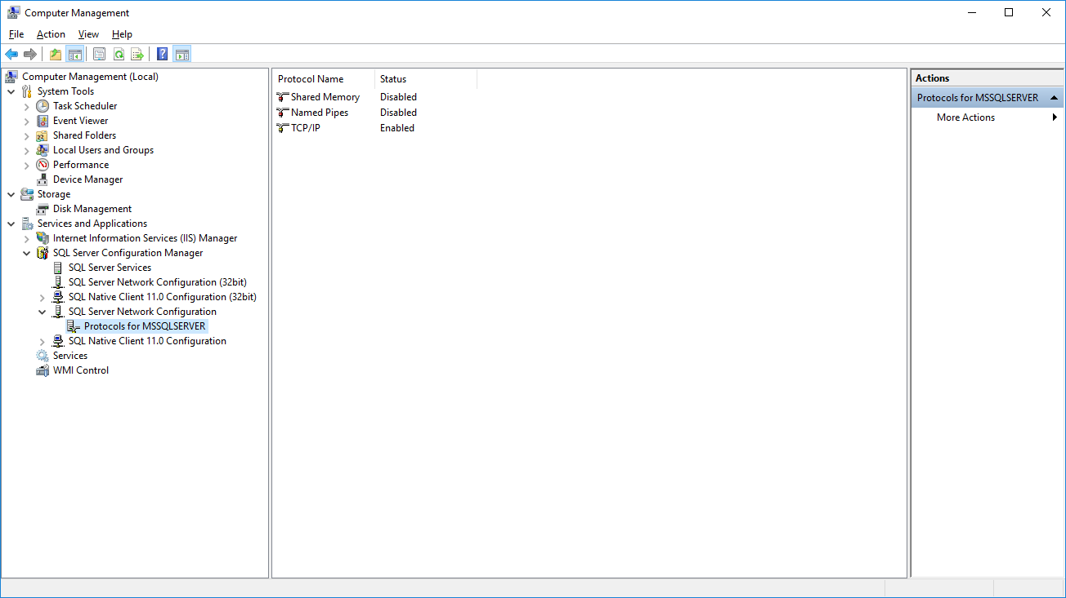
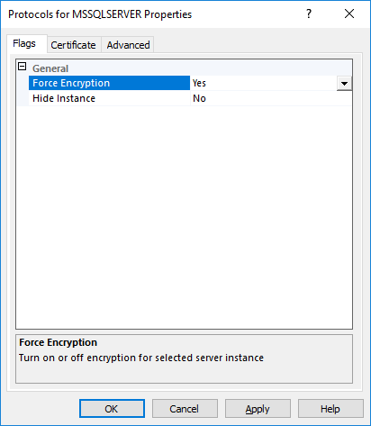
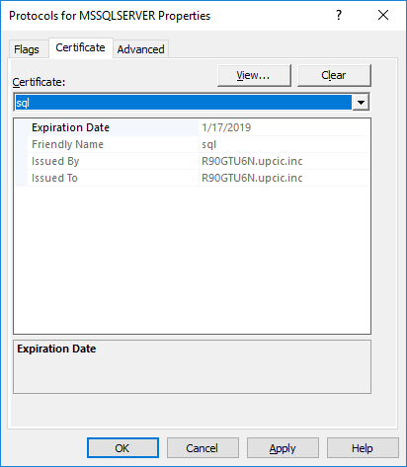
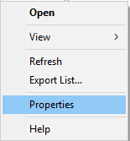
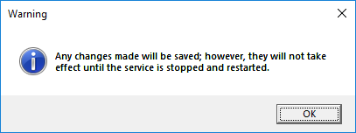
Notes:
Trollhunters MTM: (requirements: ssms, sql2008+, remote svr, vs2017 community, wireshark)
\\fldsvm_uvfile02\users$\hfleitas\SQL\PassSummit2017\20171101-1300-HackingSQLServer\TrollHunters-MITM-Demo.sql
Ref: https://docs.microsoft.com/en-us/sql/database-engine/configure-windows/enable-encrypted-connections-to-the-database-engine
Note:
To use encryption with a failover cluster, you must install the server certificate with the fully qualified DNS name of the virtual server on all nodes in the failover cluster. For example, if you have a two-node cluster, with nodes named test1.<your company>.com and test2.<your company>.com, and you have a virtual server named virtsql, you need to install a certificate for virtsql.<your company>.com on both nodes. You can set the value of the ForceEncryptionoption to Yes.

Slide 28
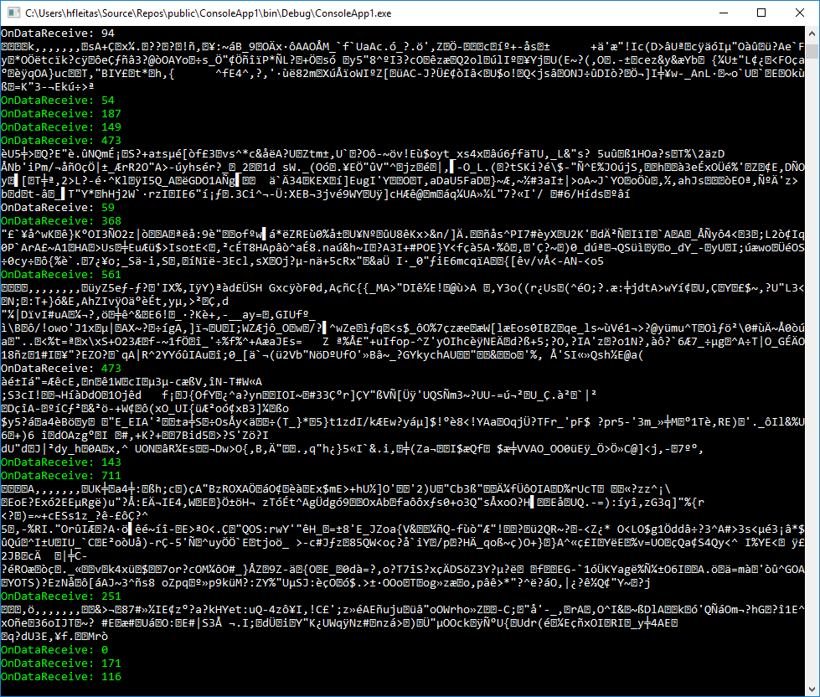
Notes:
Trollhunters MTM: (requirements: ssms, sql2008+, remote svr, vs2017 community, wireshark)
\\fldsvm_uvfile02\users$\hfleitas\SQL\PassSummit2017\20171101-1300-HackingSQLServer\TrollHunters-MITM-Demo.sql

Slide 29
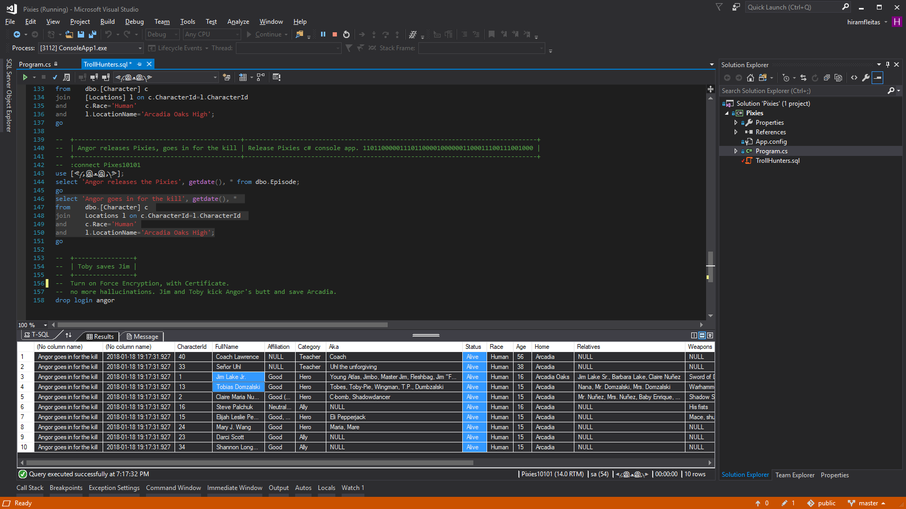
Notes:
Trollhunters MTM: (requirements: ssms, sql2008+, remote svr, vs2017 community, wireshark)
\\fldsvm_uvfile02\users$\hfleitas\SQL\PassSummit2017\20171101-1300-HackingSQLServer\TrollHunters-MITM-Demo.sql

Slide 30
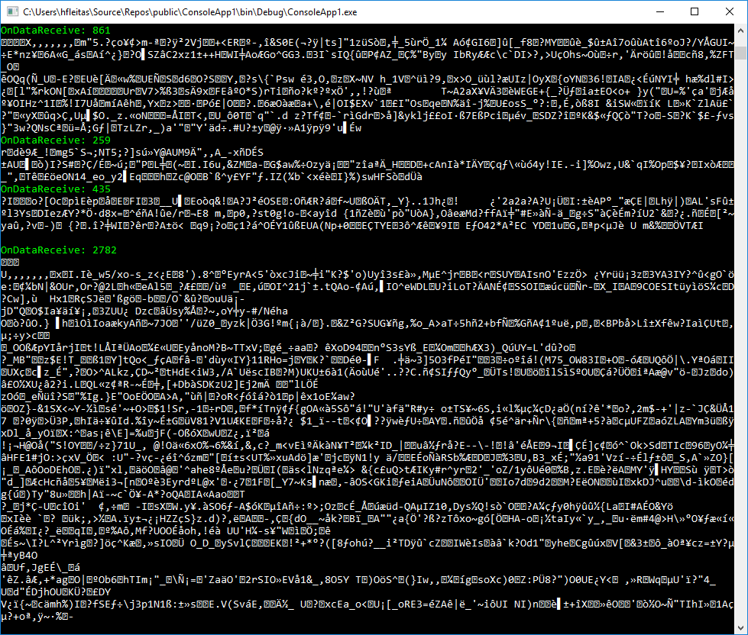
Notes:
Trollhunters MTM: (requirements: ssms, sql2008+, remote svr, vs2017 community, wireshark)
\\fldsvm_uvfile02\users$\hfleitas\SQL\PassSummit2017\20171101-1300-HackingSQLServer\TrollHunters-MITM-Demo.sql

Slide 31
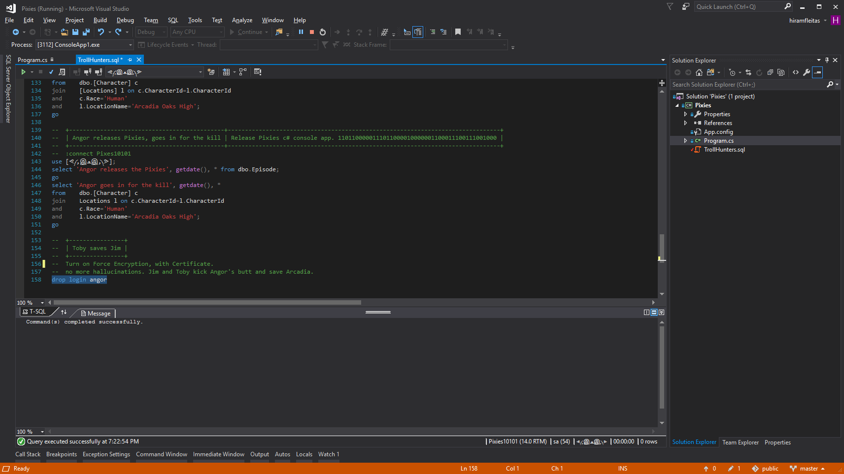
Notes:
Trollhunters MTM: (requirements: ssms, sql2008+, remote svr, vs2017 community, wireshark)
\\fldsvm_uvfile02\users$\hfleitas\SQL\PassSummit2017\20171101-1300-HackingSQLServer\TrollHunters-MITM-Demo.sql

Slide 32
DEMO 2
Load Test
Notes:
Columnstore Demo: (requirements: ssms, sql2016+)
H:\SQL\PassSummit2017\20171101-1100-TSQLTipsAndTricks\2017NeedToKnowAdaptiveJoinsOverRowstore\Demo
Performance 2017 vs 2016: (requirements: hammerdb, sql2016, sql2017)
HammerDB ASP02 (2016), SQL07 (2017) and if time allows do imoltp.
2017 Automatic Tuning: (requirements: perfmon, sqlcmd, ostress.exe, sql2017, wwi db)
C:\Deployments\demo3_sqlserverkeepsyoufast\
Copied ostress.exe into C:\Deployments\demo3_sqlserverkeepsyoufast (I had previously installed RML Utilities)
Replaced “.\sql2017” with “localhost” in files C:\Deployments\demo3_sqlserverkeepsyoufast\*.cmd (I had previously restored wwi on my local instance)
Edited setup.sql, replaced DROP procedure with DROP procedure if exists
PowerShell window 1:
PS ran .\report.cmd
PowerShell window 2:
PS perfom, performance monitor, added SQLServer:SQL Statistics:Batch Requests/sec.
PS .\repro_setup.cmd
PS .\initialize.cmd
PS .\auto_tune.cmd
PS .\regression.cmd
Docker: (requirements: docker, bios virtualization, git, stop mssql and iis local instances)
PS cd c:\deployments\sqldevops\docker_cluster\aks
Power BI:
https://community.powerbi.com/t5/Data-Stories-Gallery/US-Department-of-Transportation-Traffic-accident-analysis-1990/m-p/152287
C:\Deployments\PowerBI\USA-CAN TOR.pbix

Slide 33
Load Test Comparison

Slide 34
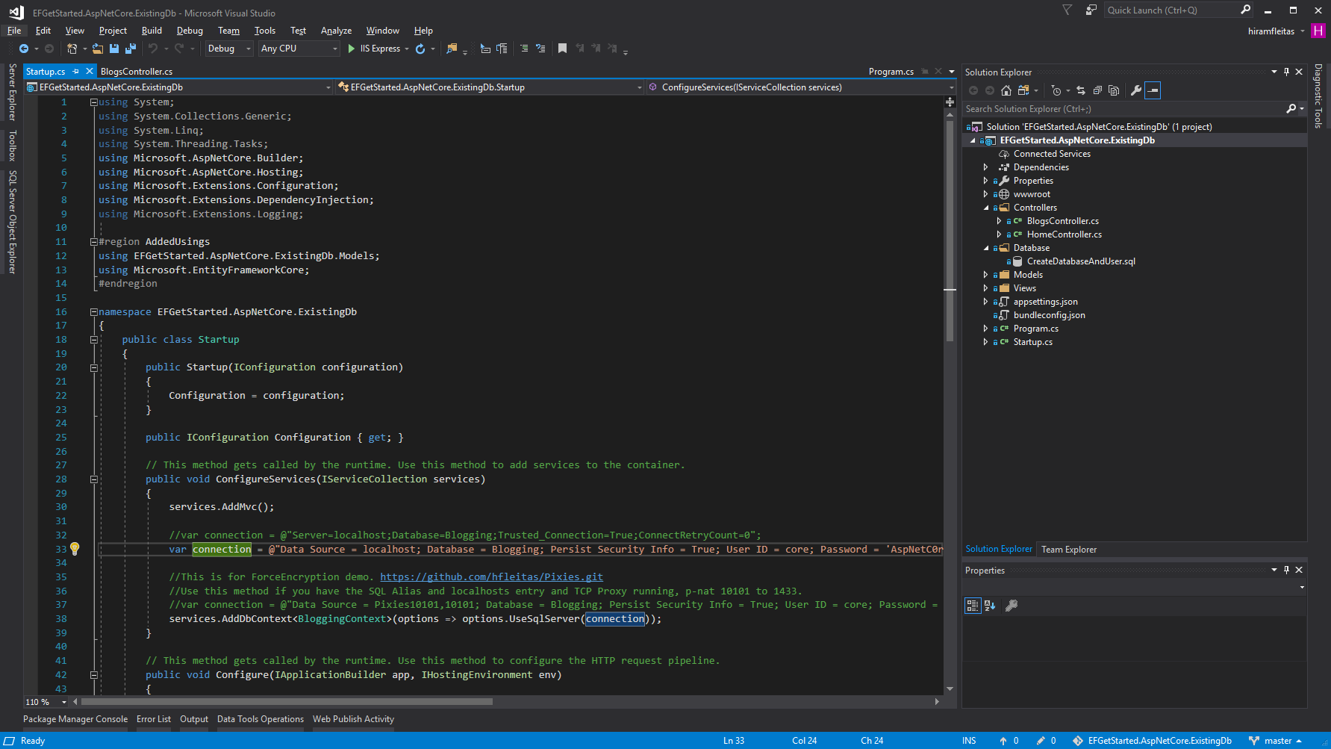
Notes:
Trollhunters MTM: (requirements: ssms, sql2008+, remote svr, vs2017 community, wireshark)
\\fldsvm_uvfile02\users$\hfleitas\SQL\PassSummit2017\20171101-1300-HackingSQLServer\TrollHunters-MITM-Demo.sql
https://github.com/hfleitas/EFGetStarted.AspNetCore.ExistingDb

Slide 35
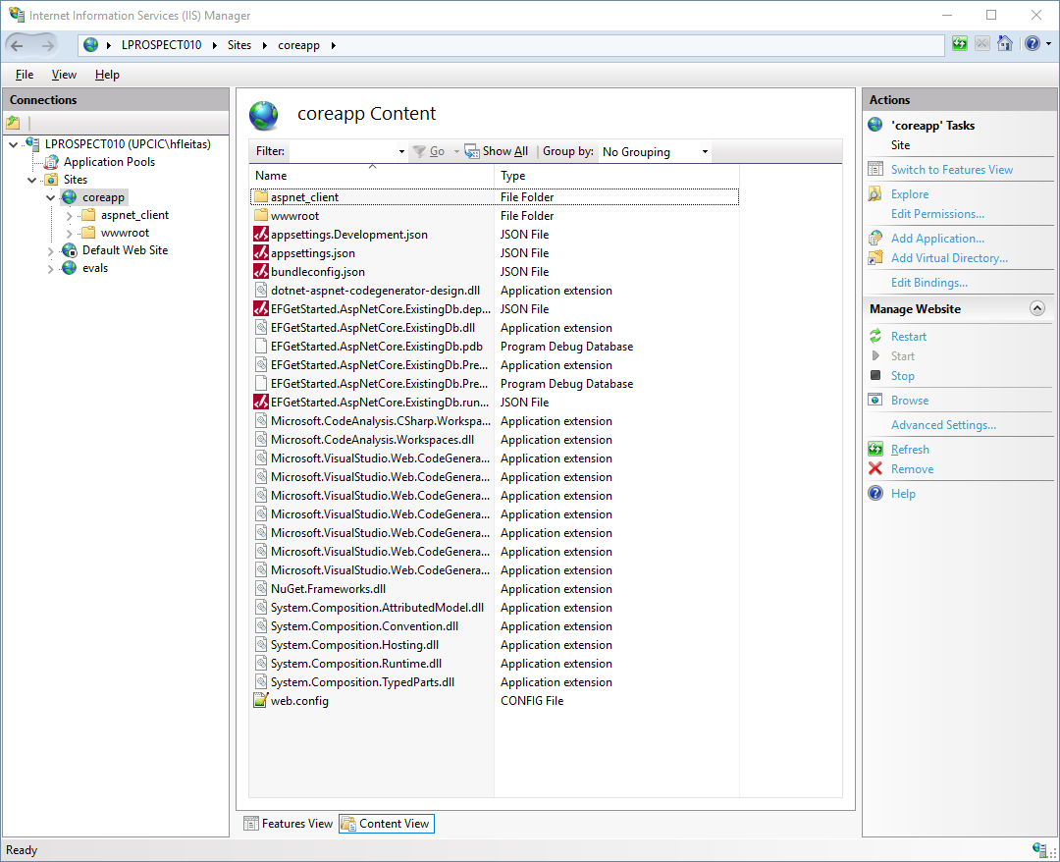
Notes:
Trollhunters MTM: (requirements: ssms, sql2008+, remote svr, vs2017 community, wireshark)
\\fldsvm_uvfile02\users$\hfleitas\SQL\PassSummit2017\20171101-1300-HackingSQLServer\TrollHunters-MITM-Demo.sql

Slide 36
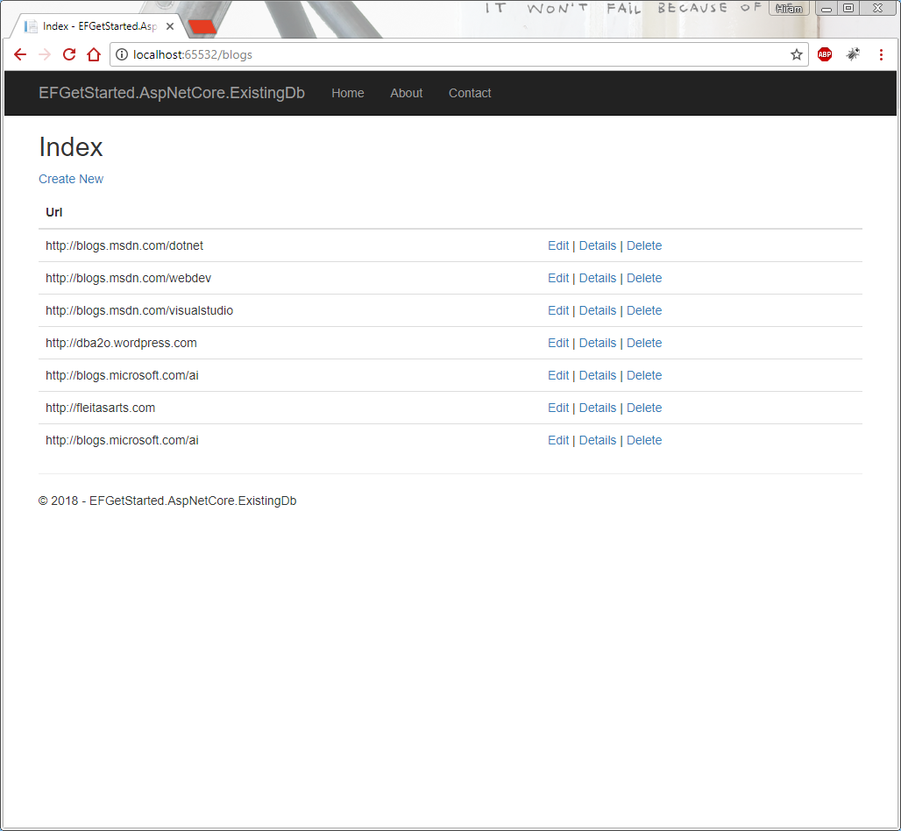
Notes:
Trollhunters MTM: (requirements: ssms, sql2008+, remote svr, vs2017 community, wireshark)
\\fldsvm_uvfile02\users$\hfleitas\SQL\PassSummit2017\20171101-1300-HackingSQLServer\TrollHunters-MITM-Demo.sql

Slide 37
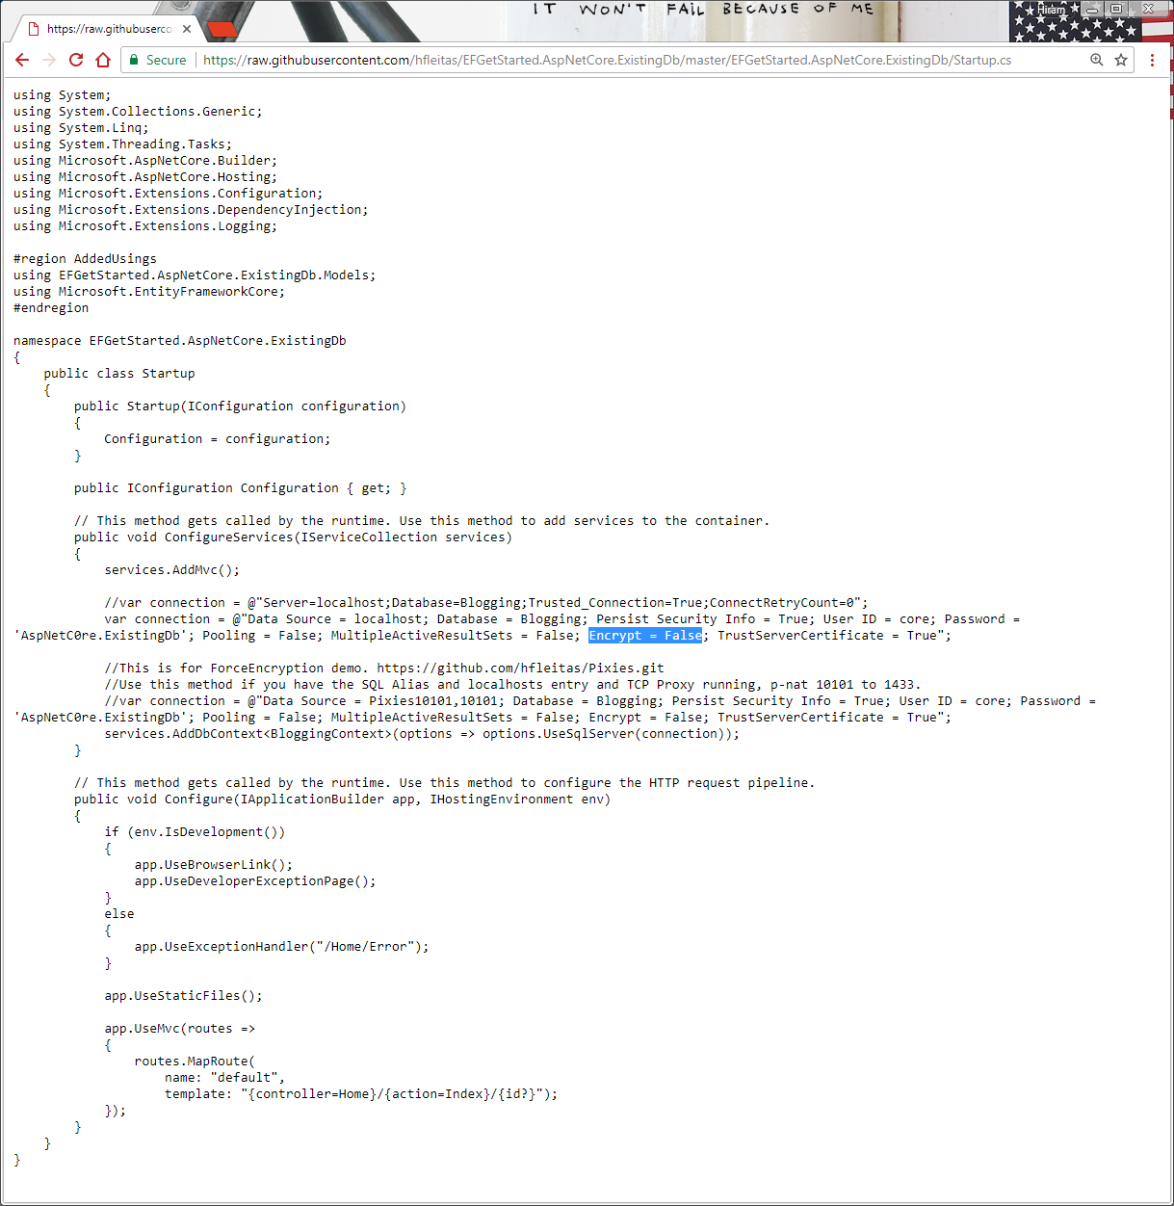
Notes:
Trollhunters MTM: (requirements: ssms, sql2008+, remote svr, vs2017 community, wireshark)
\\fldsvm_uvfile02\users$\hfleitas\SQL\PassSummit2017\20171101-1300-HackingSQLServer\TrollHunters-MITM-Demo.sql

Slide 38
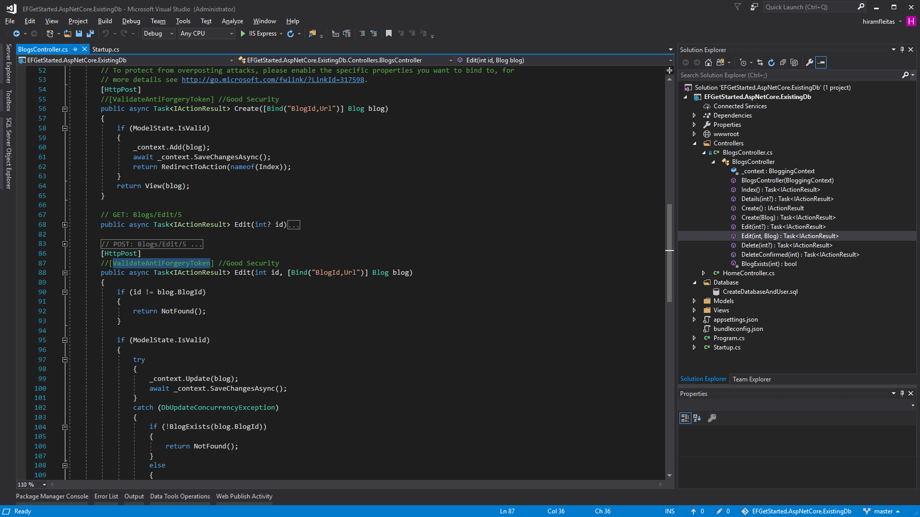
Notes:
Trollhunters MTM: (requirements: ssms, sql2008+, remote svr, vs2017 community, wireshark)
\\fldsvm_uvfile02\users$\hfleitas\SQL\PassSummit2017\20171101-1300-HackingSQLServer\TrollHunters-MITM-Demo.sql

Slide 39
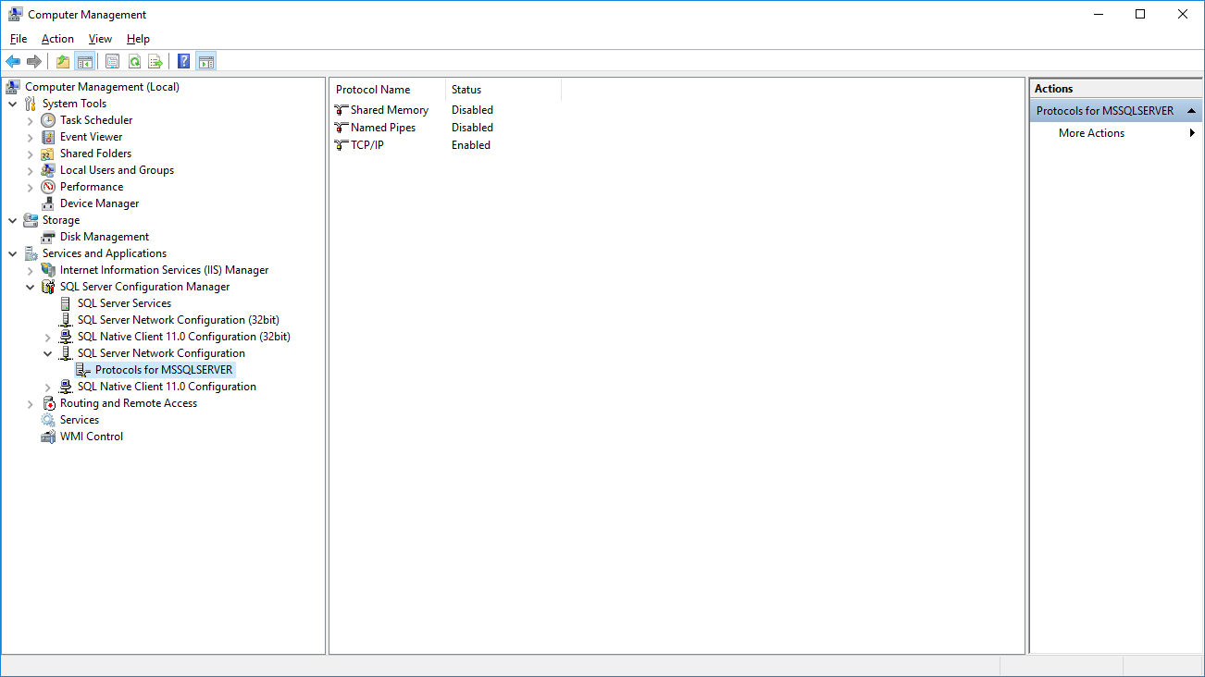

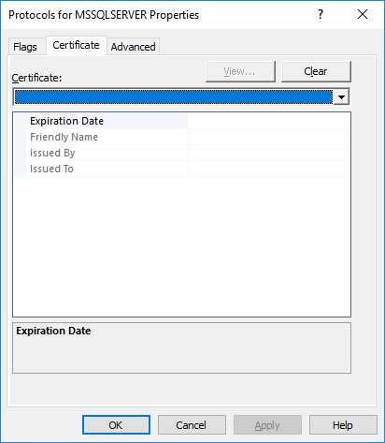
Notes:
Trollhunters MTM: (requirements: ssms, sql2008+, remote svr, vs2017 community, wireshark)
\\fldsvm_uvfile02\users$\hfleitas\SQL\PassSummit2017\20171101-1300-HackingSQLServer\TrollHunters-MITM-Demo.sql

Slide 40
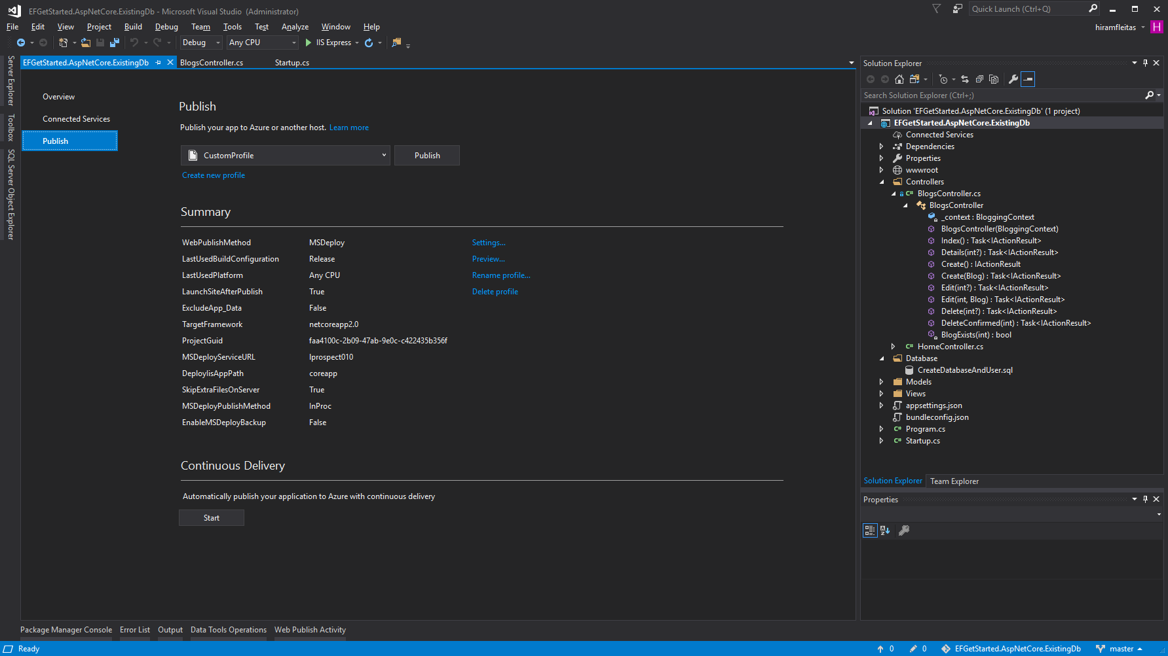
Notes:
Trollhunters MTM: (requirements: ssms, sql2008+, remote svr, vs2017 community, wireshark)
\\fldsvm_uvfile02\users$\hfleitas\SQL\PassSummit2017\20171101-1300-HackingSQLServer\TrollHunters-MITM-Demo.sql

Slide 41
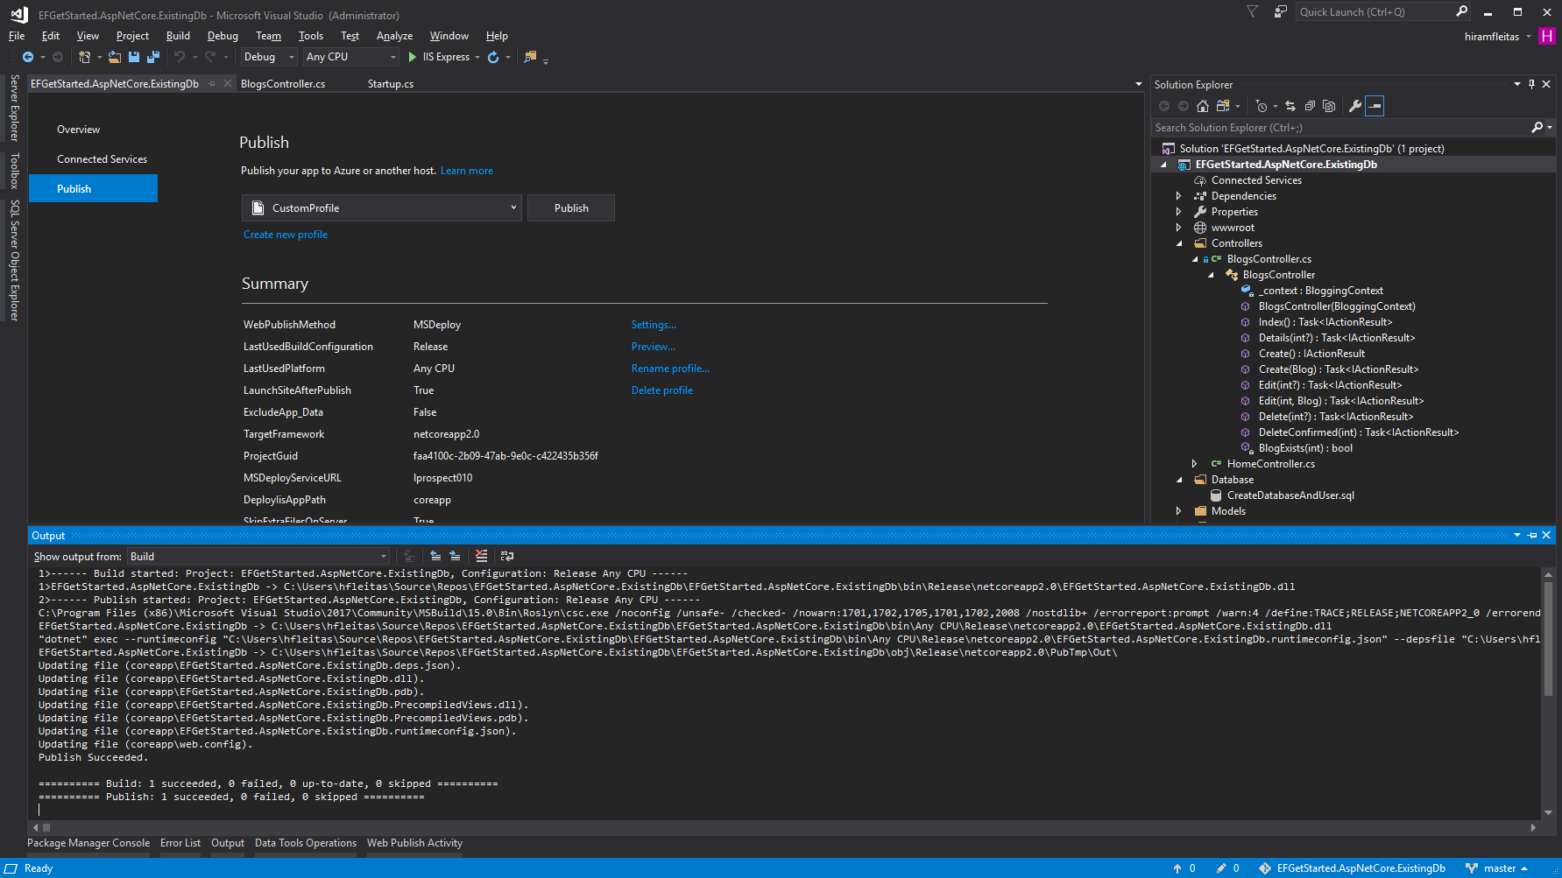
Notes:
Trollhunters MTM: (requirements: ssms, sql2008+, remote svr, vs2017 community, wireshark)
\\fldsvm_uvfile02\users$\hfleitas\SQL\PassSummit2017\20171101-1300-HackingSQLServer\TrollHunters-MITM-Demo.sql

Slide 42
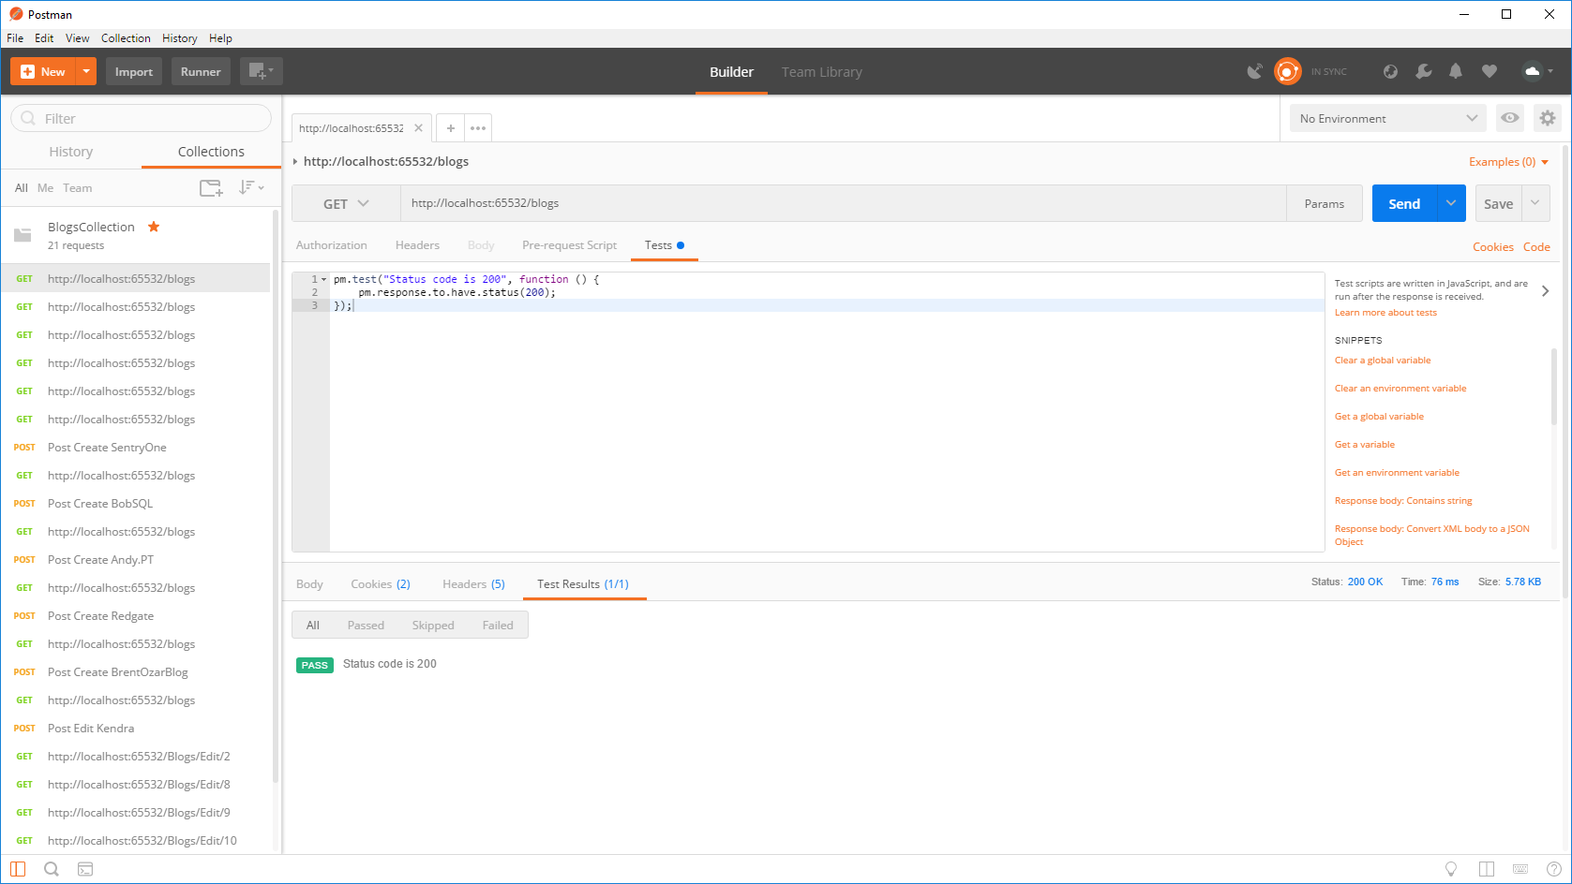
Notes:
Trollhunters MTM: (requirements: ssms, sql2008+, remote svr, vs2017 community, wireshark)
\\fldsvm_uvfile02\users$\hfleitas\SQL\PassSummit2017\20171101-1300-HackingSQLServer\TrollHunters-MITM-Demo.sql

Slide 43
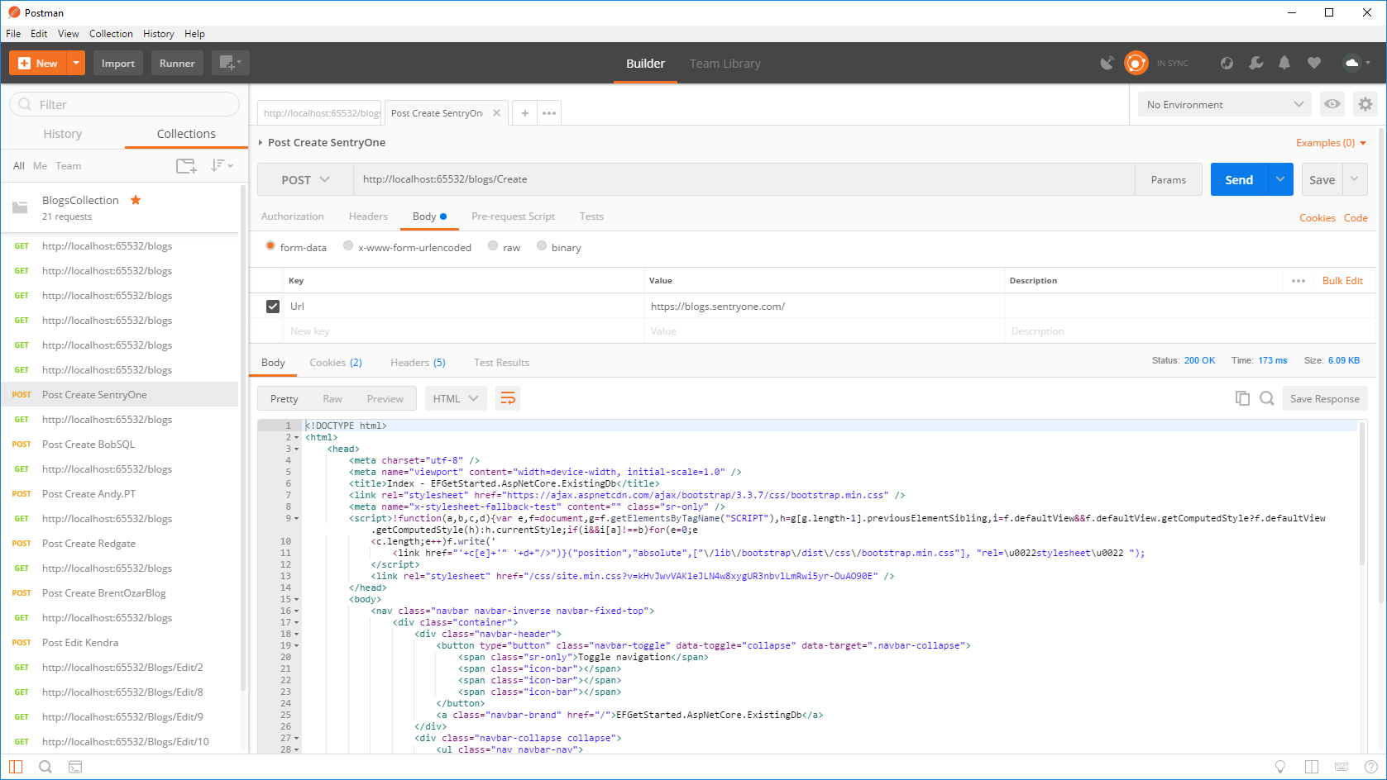
Notes:
Trollhunters MTM: (requirements: ssms, sql2008+, remote svr, vs2017 community, wireshark)
\\fldsvm_uvfile02\users$\hfleitas\SQL\PassSummit2017\20171101-1300-HackingSQLServer\TrollHunters-MITM-Demo.sql

Slide 44
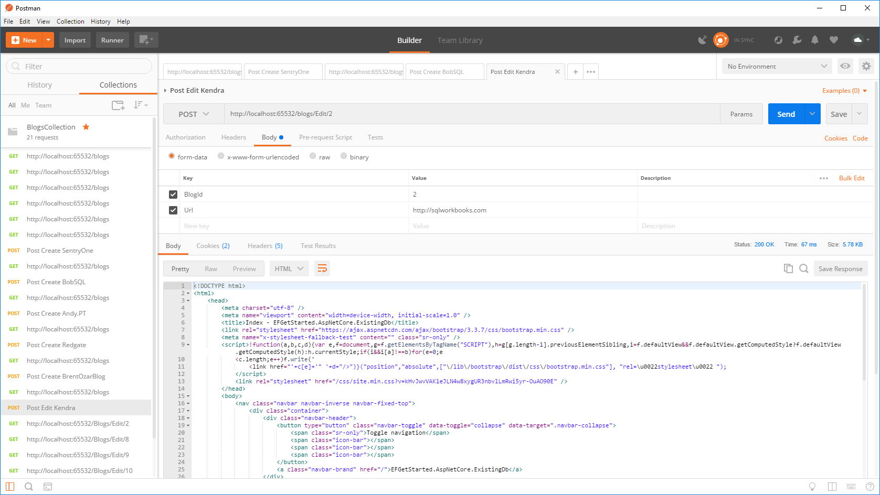
Notes:
Trollhunters MTM: (requirements: ssms, sql2008+, remote svr, vs2017 community, wireshark)
\\fldsvm_uvfile02\users$\hfleitas\SQL\PassSummit2017\20171101-1300-HackingSQLServer\TrollHunters-MITM-Demo.sql

Slide 45
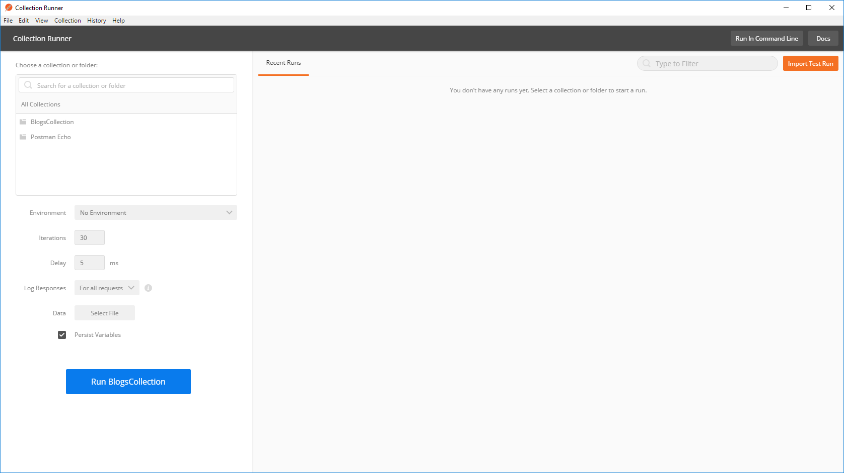
Notes:
Trollhunters MTM: (requirements: ssms, sql2008+, remote svr, vs2017 community, wireshark)
\\fldsvm_uvfile02\users$\hfleitas\SQL\PassSummit2017\20171101-1300-HackingSQLServer\TrollHunters-MITM-Demo.sql

Slide 46

Notes:
Trollhunters MTM: (requirements: ssms, sql2008+, remote svr, vs2017 community, wireshark)
\\fldsvm_uvfile02\users$\hfleitas\SQL\PassSummit2017\20171101-1300-HackingSQLServer\TrollHunters-MITM-Demo.sql

Slide 47



Notes:
Trollhunters MTM: (requirements: ssms, sql2008+, remote svr, vs2017 community, wireshark)
\\fldsvm_uvfile02\users$\hfleitas\SQL\PassSummit2017\20171101-1300-HackingSQLServer\TrollHunters-MITM-Demo.sql

Slide 48

Notes:
Trollhunters MTM: (requirements: ssms, sql2008+, remote svr, vs2017 community, wireshark)
\\fldsvm_uvfile02\users$\hfleitas\SQL\PassSummit2017\20171101-1300-HackingSQLServer\TrollHunters-MITM-Demo.sql

Slide 49
Notes:
Trollhunters MTM: (requirements: ssms, sql2008+, remote svr, vs2017 community, wireshark)
\\fldsvm_uvfile02\users$\hfleitas\SQL\PassSummit2017\20171101-1300-HackingSQLServer\TrollHunters-MITM-Demo.sql
Ref: https://docs.microsoft.com/en-us/sql/database-engine/configure-windows/enable-encrypted-connections-to-the-database-engine
Note:
To use encryption with a failover cluster, you must install the server certificate with the fully qualified DNS name of the virtual server on all nodes in the failover cluster. For example, if you have a two-node cluster, with nodes named test1.<your company>.com and test2.<your company>.com, and you have a virtual server named virtsql, you need to install a certificate for virtsql.<your company>.com on both nodes. You can set the value of the ForceEncryptionoption to Yes.

Slide 50

Notes:
Trollhunters MTM: (requirements: ssms, sql2008+, remote svr, vs2017 community, wireshark)
\\fldsvm_uvfile02\users$\hfleitas\SQL\PassSummit2017\20171101-1300-HackingSQLServer\TrollHunters-MITM-Demo.sql

Slide 51

Notes:
Trollhunters MTM: (requirements: ssms, sql2008+, remote svr, vs2017 community, wireshark)
\\fldsvm_uvfile02\users$\hfleitas\SQL\PassSummit2017\20171101-1300-HackingSQLServer\TrollHunters-MITM-Demo.sql

Slide 52
Notes:
Ref: C:\Users\hfleitas\OneDrive\Presentations\Encryption and DB Source Control\Postman\Comparison.xlsx

Slide 53
Notes:
*4 data points out of 600 skewed results due to other processes running on the machine.
Avg was 44.62ms
Removed outliers Avg is 43.71ms
Ref: C:\Users\hfleitas\OneDrive\Presentations\Encryption and DB Source Control\Postman\Comparison.xlsx

Slide 54
DEMO 3
Dynamic Data Masking
Notes:
Columnstore Demo: (requirements: ssms, sql2016+)
H:\SQL\PassSummit2017\20171101-1100-TSQLTipsAndTricks\2017NeedToKnowAdaptiveJoinsOverRowstore\Demo
Performance 2017 vs 2016: (requirements: hammerdb, sql2016, sql2017)
HammerDB ASP02 (2016), SQL07 (2017) and if time allows do imoltp.
2017 Automatic Tuning: (requirements: perfmon, sqlcmd, ostress.exe, sql2017, wwi db)
C:\Deployments\demo3_sqlserverkeepsyoufast\
Copied ostress.exe into C:\Deployments\demo3_sqlserverkeepsyoufast (I had previously installed RML Utilities)
Replaced “.\sql2017” with “localhost” in files C:\Deployments\demo3_sqlserverkeepsyoufast\*.cmd (I had previously restored wwi on my local instance)
Edited setup.sql, replaced DROP procedure with DROP procedure if exists
PowerShell window 1:
PS ran .\report.cmd
PowerShell window 2:
PS perfom, performance monitor, added SQLServer:SQL Statistics:Batch Requests/sec.
PS .\repro_setup.cmd
PS .\initialize.cmd
PS .\auto_tune.cmd
PS .\regression.cmd
Docker: (requirements: docker, bios virtualization, git, stop mssql and iis local instances)
PS cd c:\deployments\sqldevops\docker_cluster\aks
Power BI:
https://community.powerbi.com/t5/Data-Stories-Gallery/US-Department-of-Transportation-Traffic-accident-analysis-1990/m-p/152287
C:\Deployments\PowerBI\USA-CAN TOR.pbix

Slide 55

Hack DDM

Slide 56


Slide 57


Slide 58


Slide 59


Slide 60


Slide 61


Slide 62
DEMO 4
Row Level Security
Notes:
Columnstore Demo: (requirements: ssms, sql2016+)
H:\SQL\PassSummit2017\20171101-1100-TSQLTipsAndTricks\2017NeedToKnowAdaptiveJoinsOverRowstore\Demo
Performance 2017 vs 2016: (requirements: hammerdb, sql2016, sql2017)
HammerDB ASP02 (2016), SQL07 (2017) and if time allows do imoltp.
2017 Automatic Tuning: (requirements: perfmon, sqlcmd, ostress.exe, sql2017, wwi db)
C:\Deployments\demo3_sqlserverkeepsyoufast\
Copied ostress.exe into C:\Deployments\demo3_sqlserverkeepsyoufast (I had previously installed RML Utilities)
Replaced “.\sql2017” with “localhost” in files C:\Deployments\demo3_sqlserverkeepsyoufast\*.cmd (I had previously restored wwi on my local instance)
Edited setup.sql, replaced DROP procedure with DROP procedure if exists
PowerShell window 1:
PS ran .\report.cmd
PowerShell window 2:
PS perfom, performance monitor, added SQLServer:SQL Statistics:Batch Requests/sec.
PS .\repro_setup.cmd
PS .\initialize.cmd
PS .\auto_tune.cmd
PS .\regression.cmd
Docker: (requirements: docker, bios virtualization, git, stop mssql and iis local instances)
PS cd c:\deployments\sqldevops\docker_cluster\aks
Power BI:
https://community.powerbi.com/t5/Data-Stories-Gallery/US-Department-of-Transportation-Traffic-accident-analysis-1990/m-p/152287
C:\Deployments\PowerBI\USA-CAN TOR.pbix

Slide 63

Hack RLS

Slide 65


Slide 66


Slide 67


Slide 68


Slide 69


Slide 70


Slide 71


Slide 72


Slide 73


Slide 74


Slide 75


Slide 76


Slide 77

Notes:
http://hiram/summit2017/Player.html?SID=65982
https://1drv.ms/v/s!Aq04euwkcR1Gri1eHpuMq90INzqP
See minute 47.

Slide 78


Slide 79


Slide 81
DEMO 5
Database Project
Version & Source Control
Notes:
Columnstore Demo: (requirements: ssms, sql2016+)
H:\SQL\PassSummit2017\20171101-1100-TSQLTipsAndTricks\2017NeedToKnowAdaptiveJoinsOverRowstore\Demo
Performance 2017 vs 2016: (requirements: hammerdb, sql2016, sql2017)
HammerDB ASP02 (2016), SQL07 (2017) and if time allows do imoltp.
2017 Automatic Tuning: (requirements: perfmon, sqlcmd, ostress.exe, sql2017, wwi db)
C:\Deployments\demo3_sqlserverkeepsyoufast\
Copied ostress.exe into C:\Deployments\demo3_sqlserverkeepsyoufast (I had previously installed RML Utilities)
Replaced “.\sql2017” with “localhost” in files C:\Deployments\demo3_sqlserverkeepsyoufast\*.cmd (I had previously restored wwi on my local instance)
Edited setup.sql, replaced DROP procedure with DROP procedure if exists
PowerShell window 1:
PS ran .\report.cmd
PowerShell window 2:
PS perfom, performance monitor, added SQLServer:SQL Statistics:Batch Requests/sec.
PS .\repro_setup.cmd
PS .\initialize.cmd
PS .\auto_tune.cmd
PS .\regression.cmd
Docker: (requirements: docker, bios virtualization, git, stop mssql and iis local instances)
PS cd c:\deployments\sqldevops\docker_cluster\aks
Power BI:
https://community.powerbi.com/t5/Data-Stories-Gallery/US-Department-of-Transportation-Traffic-accident-analysis-1990/m-p/152287
C:\Deployments\PowerBI\USA-CAN TOR.pbix

Slide 82

DB Source Control

Slide 83

Notes:
https://github.com/hfleitas/EFGetStarted.AspNetCore.ExistingDb
Force Encryption
TFS/SVN Database code project
VS, Create proj, import db, tfs commit, make changes outside, schema compare (update), commit.

Slide 84


Notes:
https://github.com/hfleitas/EFGetStarted.AspNetCore.ExistingDb
Force Encryption
TFS/SVN Database code project
VS, Create proj, import db, tfs commit, make changes outside, schema compare (update), commit.

Slide 85

Notes:
https://github.com/hfleitas/EFGetStarted.AspNetCore.ExistingDb
Force Encryption
TFS/SVN Database code project
VS, Create proj, import db, tfs commit, make changes outside, schema compare (update), commit.

Slide 86



Notes:
https://github.com/hfleitas/EFGetStarted.AspNetCore.ExistingDb
Force Encryption
TFS/SVN Database code project
VS, Create proj, import db, tfs commit, make changes outside, schema compare (update), commit.

Slide 87

Notes:
https://github.com/hfleitas/EFGetStarted.AspNetCore.ExistingDb
Force Encryption
TFS/SVN Database code project
VS, Create proj, import db, tfs commit, make changes outside, schema compare (update), commit.

Slide 88


Notes:
https://github.com/hfleitas/EFGetStarted.AspNetCore.ExistingDb
Force Encryption
TFS/SVN Database code project
VS, Create proj, import db, tfs commit, make changes outside, schema compare (update), commit.

Slide 89

Notes:
https://github.com/hfleitas/EFGetStarted.AspNetCore.ExistingDb
Force Encryption
TFS/SVN Database code project
VS, Create proj, import db, tfs commit, make changes outside, schema compare (update), commit.

Slide 90
TFS
Section
Notes:
Columnstore Demo: (requirements: ssms, sql2016+)
H:\SQL\PassSummit2017\20171101-1100-TSQLTipsAndTricks\2017NeedToKnowAdaptiveJoinsOverRowstore\Demo
Performance 2017 vs 2016: (requirements: hammerdb, sql2016, sql2017)
HammerDB ASP02 (2016), SQL07 (2017) and if time allows do imoltp.
2017 Automatic Tuning: (requirements: perfmon, sqlcmd, ostress.exe, sql2017, wwi db)
C:\Deployments\demo3_sqlserverkeepsyoufast\
Copied ostress.exe into C:\Deployments\demo3_sqlserverkeepsyoufast (I had previously installed RML Utilities)
Replaced “.\sql2017” with “localhost” in files C:\Deployments\demo3_sqlserverkeepsyoufast\*.cmd (I had previously restored wwi on my local instance)
Edited setup.sql, replaced DROP procedure with DROP procedure if exists
PowerShell window 1:
PS ran .\report.cmd
PowerShell window 2:
PS perfom, performance monitor, added SQLServer:SQL Statistics:Batch Requests/sec.
PS .\repro_setup.cmd
PS .\initialize.cmd
PS .\auto_tune.cmd
PS .\regression.cmd
Docker: (requirements: docker, bios virtualization, git, stop mssql and iis local instances)
PS cd c:\deployments\sqldevops\docker_cluster\aks
Power BI:
https://community.powerbi.com/t5/Data-Stories-Gallery/US-Department-of-Transportation-Traffic-accident-analysis-1990/m-p/152287
C:\Deployments\PowerBI\USA-CAN TOR.pbix

Slide 91




Notes:
https://github.com/hfleitas/EFGetStarted.AspNetCore.ExistingDb
Force Encryption
TFS/SVN Database code project
VS, Create proj, import db, tfs commit, make changes outside, schema compare (update), commit.

Slide 92

Notes:
https://github.com/hfleitas/EFGetStarted.AspNetCore.ExistingDb
Force Encryption
TFS/SVN Database code project
VS, Create proj, import db, tfs commit, make changes outside, schema compare (update), commit.

Slide 93


Notes:
https://github.com/hfleitas/EFGetStarted.AspNetCore.ExistingDb
Force Encryption
TFS/SVN Database code project
VS, Create proj, import db, tfs commit, make changes outside, schema compare (update), commit.

Slide 94

Notes:
https://github.com/hfleitas/EFGetStarted.AspNetCore.ExistingDb
Force Encryption
TFS/SVN Database code project
VS, Create proj, import db, tfs commit, make changes outside, schema compare (update), commit.

Slide 95

Notes:
https://github.com/hfleitas/EFGetStarted.AspNetCore.ExistingDb
Force Encryption
TFS/SVN Database code project
VS, Create proj, import db, tfs commit, make changes outside, schema compare (update), commit.

Slide 96

Notes:
https://github.com/hfleitas/EFGetStarted.AspNetCore.ExistingDb
Force Encryption
TFS/SVN Database code project
VS, Create proj, import db, tfs commit, make changes outside, schema compare (update), commit.

Slide 97

Notes:
https://github.com/hfleitas/EFGetStarted.AspNetCore.ExistingDb
Force Encryption
TFS/SVN Database code project
VS, Create proj, import db, tfs commit, make changes outside, schema compare (update), commit.

Slide 98

Notes:
https://github.com/hfleitas/EFGetStarted.AspNetCore.ExistingDb
Force Encryption
TFS/SVN Database code project
VS, Create proj, import db, tfs commit, make changes outside, schema compare (update), commit.

Slide 99

Notes:
https://github.com/hfleitas/EFGetStarted.AspNetCore.ExistingDb
Force Encryption
TFS/SVN Database code project
VS, Create proj, import db, tfs commit, make changes outside, schema compare (update), commit.

Slide 100



Notes:
https://github.com/hfleitas/EFGetStarted.AspNetCore.ExistingDb
Force Encryption
TFS/SVN Database code project
VS, Create proj, import db, tfs commit, make changes outside, schema compare (update), commit.

Slide 101



Notes:
https://github.com/hfleitas/EFGetStarted.AspNetCore.ExistingDb
Force Encryption
TFS/SVN Database code project
VS, Create proj, import db, tfs commit, make changes outside, schema compare (update), commit.

Slide 102

Notes:
https://github.com/hfleitas/EFGetStarted.AspNetCore.ExistingDb
Force Encryption
TFS/SVN Database code project
VS, Create proj, import db, tfs commit, make changes outside, schema compare (update), commit.

Slide 103

Notes:
https://github.com/hfleitas/EFGetStarted.AspNetCore.ExistingDb
Force Encryption
TFS/SVN Database code project
VS, Create proj, import db, tfs commit, make changes outside, schema compare (update), commit.

Slide 104

Notes:
https://github.com/hfleitas/EFGetStarted.AspNetCore.ExistingDb
Force Encryption
TFS/SVN Database code project
VS, Create proj, import db, tfs commit, make changes outside, schema compare (update), commit.

Slide 105

Notes:
https://github.com/hfleitas/EFGetStarted.AspNetCore.ExistingDb
Force Encryption
TFS/SVN Database code project
VS, Create proj, import db, tfs commit, make changes outside, schema compare (update), commit.

Slide 106

Notes:
https://github.com/hfleitas/EFGetStarted.AspNetCore.ExistingDb
Force Encryption
TFS/SVN Database code project
VS, Create proj, import db, tfs commit, make changes outside, schema compare (update), commit.

Slide 107

Notes:
https://github.com/hfleitas/EFGetStarted.AspNetCore.ExistingDb
Force Encryption
TFS/SVN Database code project
VS, Create proj, import db, tfs commit, make changes outside, schema compare (update), commit.

Slide 108

Notes:
https://github.com/hfleitas/EFGetStarted.AspNetCore.ExistingDb
Force Encryption
TFS/SVN Database code project
VS, Create proj, import db, tfs commit, make changes outside, schema compare (update), commit.

Slide 109

Notes:
https://github.com/hfleitas/EFGetStarted.AspNetCore.ExistingDb
Force Encryption
TFS/SVN Database code project
VS, Create proj, import db, tfs commit, make changes outside, schema compare (update), commit.

Slide 110

Notes:
https://github.com/hfleitas/EFGetStarted.AspNetCore.ExistingDb
Force Encryption
TFS/SVN Database code project
VS, Create proj, import db, tfs commit, make changes outside, schema compare (update), commit.

Slide 111

Notes:
https://github.com/hfleitas/EFGetStarted.AspNetCore.ExistingDb
Force Encryption
TFS/SVN Database code project
VS, Create proj, import db, tfs commit, make changes outside, schema compare (update), commit.

Slide 112

Notes:
https://github.com/hfleitas/EFGetStarted.AspNetCore.ExistingDb
Force Encryption
TFS/SVN Database code project
VS, Create proj, import db, tfs commit, make changes outside, schema compare (update), commit.

Slide 113


Notes:
https://github.com/hfleitas/EFGetStarted.AspNetCore.ExistingDb
Force Encryption
TFS/SVN Database code project
VS, Create proj, import db, tfs commit, make changes outside, schema compare (update), commit.

Slide 114

Notes:
https://github.com/hfleitas/EFGetStarted.AspNetCore.ExistingDb
Force Encryption
TFS/SVN Database code project
VS, Create proj, import db, tfs commit, make changes outside, schema compare (update), commit.

Slide 115

Notes:
https://github.com/hfleitas/EFGetStarted.AspNetCore.ExistingDb
Force Encryption
TFS/SVN Database code project
VS, Create proj, import db, tfs commit, make changes outside, schema compare (update), commit.

Slide 116

Notes:
https://github.com/hfleitas/EFGetStarted.AspNetCore.ExistingDb
Force Encryption
TFS/SVN Database code project
VS, Create proj, import db, tfs commit, make changes outside, schema compare (update), commit.

Slide 117
GitHub
Section
Notes:
Columnstore Demo: (requirements: ssms, sql2016+)
H:\SQL\PassSummit2017\20171101-1100-TSQLTipsAndTricks\2017NeedToKnowAdaptiveJoinsOverRowstore\Demo
Performance 2017 vs 2016: (requirements: hammerdb, sql2016, sql2017)
HammerDB ASP02 (2016), SQL07 (2017) and if time allows do imoltp.
2017 Automatic Tuning: (requirements: perfmon, sqlcmd, ostress.exe, sql2017, wwi db)
C:\Deployments\demo3_sqlserverkeepsyoufast\
Copied ostress.exe into C:\Deployments\demo3_sqlserverkeepsyoufast (I had previously installed RML Utilities)
Replaced “.\sql2017” with “localhost” in files C:\Deployments\demo3_sqlserverkeepsyoufast\*.cmd (I had previously restored wwi on my local instance)
Edited setup.sql, replaced DROP procedure with DROP procedure if exists
PowerShell window 1:
PS ran .\report.cmd
PowerShell window 2:
PS perfom, performance monitor, added SQLServer:SQL Statistics:Batch Requests/sec.
PS .\repro_setup.cmd
PS .\initialize.cmd
PS .\auto_tune.cmd
PS .\regression.cmd
Docker: (requirements: docker, bios virtualization, git, stop mssql and iis local instances)
PS cd c:\deployments\sqldevops\docker_cluster\aks
Power BI:
https://community.powerbi.com/t5/Data-Stories-Gallery/US-Department-of-Transportation-Traffic-accident-analysis-1990/m-p/152287
C:\Deployments\PowerBI\USA-CAN TOR.pbix

Slide 118
Notes:
https://github.com/hfleitas/EFGetStarted.AspNetCore.ExistingDb
Force Encryption
TFS/SVN Database code project
VS, Create proj, import db, tfs commit, make changes outside, schema compare (update), commit.

Slide 119

Notes:
https://github.com/hfleitas/EFGetStarted.AspNetCore.ExistingDb
Force Encryption
TFS/SVN Database code project
VS, Create proj, import db, tfs commit, make changes outside, schema compare (update), commit.

Slide 120

Notes:
https://github.com/hfleitas/EFGetStarted.AspNetCore.ExistingDb
Force Encryption
TFS/SVN Database code project
VS, Create proj, import db, tfs commit, make changes outside, schema compare (update), commit.

Slide 121

Notes:
https://github.com/hfleitas/EFGetStarted.AspNetCore.ExistingDb
Force Encryption
TFS/SVN Database code project
VS, Create proj, import db, tfs commit, make changes outside, schema compare (update), commit.

Slide 122

Notes:
https://github.com/hfleitas/EFGetStarted.AspNetCore.ExistingDb
Force Encryption
TFS/SVN Database code project
VS, Create proj, import db, tfs commit, make changes outside, schema compare (update), commit.

Slide 123

Notes:
https://github.com/hfleitas/EFGetStarted.AspNetCore.ExistingDb
Force Encryption
TFS/SVN Database code project
VS, Create proj, import db, tfs commit, make changes outside, schema compare (update), commit.

Slide 124

Notes:
https://github.com/hfleitas/EFGetStarted.AspNetCore.ExistingDb
Force Encryption
TFS/SVN Database code project
VS, Create proj, import db, tfs commit, make changes outside, schema compare (update), commit.

Slide 125

Notes:
https://github.com/hfleitas/EFGetStarted.AspNetCore.ExistingDb
Force Encryption
TFS/SVN Database code project
VS, Create proj, import db, tfs commit, make changes outside, schema compare (update), commit.

Slide 126

Notes:
https://github.com/hfleitas/EFGetStarted.AspNetCore.ExistingDb
Force Encryption
TFS/SVN Database code project
VS, Create proj, import db, tfs commit, make changes outside, schema compare (update), commit.

Slide 127

Notes:
https://github.com/hfleitas/EFGetStarted.AspNetCore.ExistingDb
Force Encryption
TFS/SVN Database code project
VS, Create proj, import db, tfs commit, make changes outside, schema compare (update), commit.

Slide 128

Notes:
https://github.com/hfleitas/EFGetStarted.AspNetCore.ExistingDb
Force Encryption
TFS/SVN Database code project
VS, Create proj, import db, tfs commit, make changes outside, schema compare (update), commit.

Slide 129

Notes:
https://github.com/hfleitas/EFGetStarted.AspNetCore.ExistingDb
Force Encryption
TFS/SVN Database code project
VS, Create proj, import db, tfs commit, make changes outside, schema compare (update), commit.

Slide 130

Notes:
https://github.com/hfleitas/EFGetStarted.AspNetCore.ExistingDb
Force Encryption
TFS/SVN Database code project
VS, Create proj, import db, tfs commit, make changes outside, schema compare (update), commit.

Slide 131

Notes:
https://github.com/hfleitas/EFGetStarted.AspNetCore.ExistingDb
Force Encryption
TFS/SVN Database code project
VS, Create proj, import db, tfs commit, make changes outside, schema compare (update), commit.

Slide 132

Notes:
https://github.com/hfleitas/EFGetStarted.AspNetCore.ExistingDb
Force Encryption
TFS/SVN Database code project
VS, Create proj, import db, tfs commit, make changes outside, schema compare (update), commit.

Slide 133

Notes:
https://github.com/hfleitas/EFGetStarted.AspNetCore.ExistingDb
Force Encryption
TFS/SVN Database code project
VS, Create proj, import db, tfs commit, make changes outside, schema compare (update), commit.

Slide 134
Notes:
https://github.com/hfleitas/EFGetStarted.AspNetCore.ExistingDb
Force Encryption
TFS/SVN Database code project
VS, Create proj, import db, tfs commit, make changes outside, schema compare (update), commit.

Slide 135
DEMO 6
SQL Server
Machine Learning & AI
Notes:
Columnstore Demo: (requirements: ssms, sql2016+)
H:\SQL\PassSummit2017\20171101-1100-TSQLTipsAndTricks\2017NeedToKnowAdaptiveJoinsOverRowstore\Demo
Performance 2017 vs 2016: (requirements: hammerdb, sql2016, sql2017)
HammerDB ASP02 (2016), SQL07 (2017) and if time allows do imoltp.
2017 Automatic Tuning: (requirements: perfmon, sqlcmd, ostress.exe, sql2017, wwi db)
C:\Deployments\demo3_sqlserverkeepsyoufast\
Copied ostress.exe into C:\Deployments\demo3_sqlserverkeepsyoufast (I had previously installed RML Utilities)
Replaced “.\sql2017” with “localhost” in files C:\Deployments\demo3_sqlserverkeepsyoufast\*.cmd (I had previously restored wwi on my local instance)
Edited setup.sql, replaced DROP procedure with DROP procedure if exists
PowerShell window 1:
PS ran .\report.cmd
PowerShell window 2:
PS perfom, performance monitor, added SQLServer:SQL Statistics:Batch Requests/sec.
PS .\repro_setup.cmd
PS .\initialize.cmd
PS .\auto_tune.cmd
PS .\regression.cmd
Docker: (requirements: docker, bios virtualization, git, stop mssql and iis local instances)
PS cd c:\deployments\sqldevops\docker_cluster\aks
Power BI:
https://community.powerbi.com/t5/Data-Stories-Gallery/US-Department-of-Transportation-Traffic-accident-analysis-1990/m-p/152287
C:\Deployments\PowerBI\USA-CAN TOR.pbix

Slide 136

SQL ML / AI

Slide 137


Notes:
https://www.netflix.com/title/80075820

Slide 138


Slide 139



Slide 140

Not in 2019ctp2

Slide 141



2017
2019ctp2

Slide 142


Slide 143


2017
2019ctp2

Slide 144

2019ctp2

Slide 145

2017

Slide 146

2019ctp2

Slide 147


Slide 148


Slide 149



Slide 150


Slide 151


Slide 152



Slide 153


Slide 154


Slide 155


Slide 156


Slide 157


Slide 158


Slide 159



Slide 160


Slide 161


Slide 162



Slide 163


Slide 164



Slide 165


Slide 166


Slide 167


Slide 168


Slide 171
Resources
Hiram Fleitas
Tues, Oct 30
6 - 9 PM
DBA Advanced
Slides, Scripts, Recordings, Notes:
Public: https://goo.gl/BqfYSi
Best of Summit: Best of 2017
PASStv: http://pass.org/summit/2017/PASStv.aspx
Keynote Day 1: https://youtu.be/NGbk9XGWTHI
Microsoft BI - An Integrated Modern Solution: https://youtu.be/T0If-SNl08A
Keynote Day 2: https://youtu.be/7SRi9vyDtWY
Keynote Day 3 (WIT): https://youtu.be/8JnXi0gnTb8
Speakers: 2018
Bob Ward’s slides & scripts: http://aka.ms/bobwardms
Performance: Adaptive Query Processing, Automatic Tuning.
Docker: Quickstart
Docker SQL, App, CI/CD: Channel9
Postman: Get Postman
SSDT: Download SQL Server Data Tools
TFS Pricing: https://visualstudio.com/team-services/tfs-pricing
GitHub Pricing: https://github.com/pricing
The Roadmap for SQL Server 2019: MSSQL Tiger Team Playlist
Pre-Trained Deep Neural Network Models: Image Featurization
More:
@sqlpass, #PASSSummit, #powerbihelp, #sqlhelp, @MSPowerBI, @mssqltiger
Join Slack workspace: http://dbatools.io/slack
Slack channels: #dbatools, #firstresponderkit, #general, #pass-summit, #query-tuning, #sqlhelp, #git-help
Pass Virtual Groups: Community Groups (App Dev, BI, DBA, DevOps, Global Spanish, HA/DR, Performance, PowerShell, Virtualization, Linux)
More webinars: Channel9, GroupBy, SQLWorkBooks
Microsoft AI: AI School Learning Paths
Models: Install pre-trained Machine Learning models on SQL Server
Tutorials: Get Started with SQL Server Machine Learning Services
Interaction of Components: SQL Server Components to Support Python
Threading ML: Logistic Regression
Resource Governor: Alter External Resource Pool
Product Reviews Dataset: Amazon Customer Reviews Dataset
Spyder IDE: Download Spyder with Anaconda (631MB)
VSCode: Download (43 MB)
Visual Studio: Downloads

Slide 172
Session evaluations Your feedback is important and valuable.
goo.gl/QEkoDi
Submit your feedback by the end of this session to win a prize.
goo.gl/QEkoDi
http://hiram/evals

Slide 173

Sponsor
Notes:
Performance 2017 vs 2016: (requirements: hammerdb, sql2016, sql2017)
HammerDB ASP02 (2016), SQL07 (2017) and if time allows do imoltp.

Slide 174

Thank You Hit me up!
/HiramFleitas
/hfleitas
@HiramFleitas
hiramfleitas@hotmail.com
HiramFleitas
dba2o.wordpress.com

